Slide 1
Improving nutrient use and manure management towards sustainable and resilient agricultural systems in the context of Ghana
Kingsley K. Amoako
Ministry of Food and Agriculture, Ghana
3rd December 2019

Slide 2
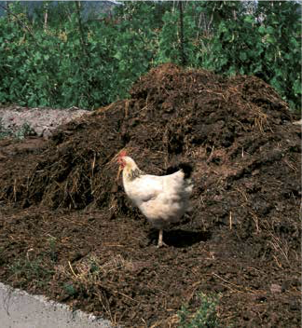
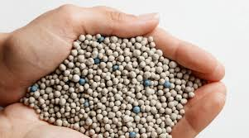
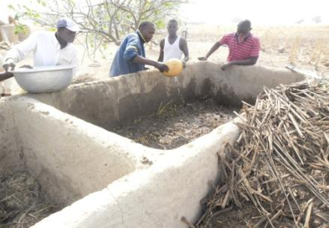
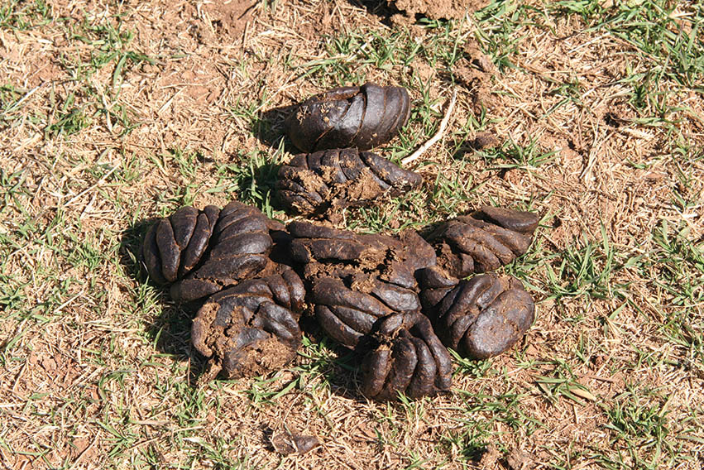
Sources of soil nutrients and manure in Africa
Organic sources:
Cattle manure
Poultry manure
Crop residue
Inorganic sources:
Synthetic fertilizers

Slide 3
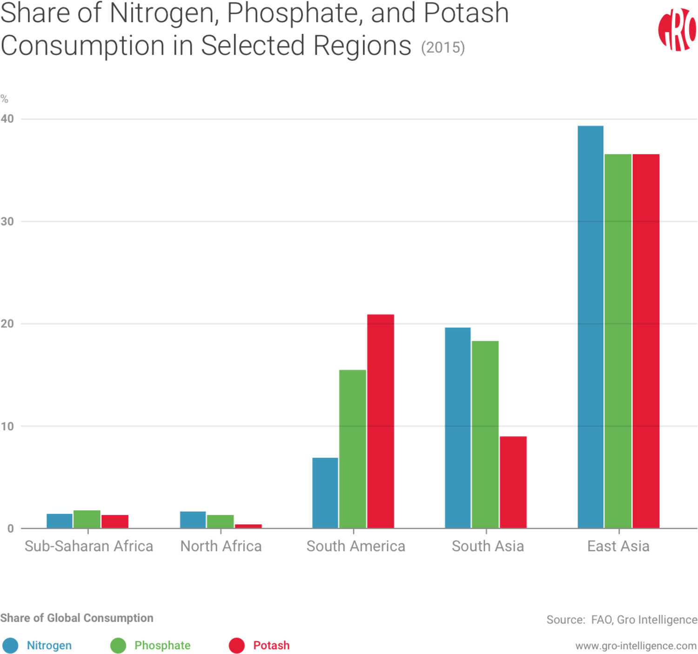
Fertilize use in selected regions

Slide 4
Reasons for low use of fertilizers in Africa
Sub-Saharan Africa is the World’s Most Expensive Fertilizer Market
A 2011 study found that fertilizer costs in sub-Saharan Africa were at least four times more expensive than they were in Europe.
High transportation cost
  Ocean shipping
  Inland trucking and rail cost
Fertilizer production on the continent is low and difficult due to;
  High cost of raw materials
  High production energy requirement

Slide 5
Africa’s ambitious targets for nutrient use
AU Abuja declaration in 2006 encouraged the African Union Member States to increase the level of fertilizer use from average of 8 kilograms per hectare by then to an average of 50 kilograms per hectare by 2015. This target has not been achieved.
Currently, fertilizer use in Africa is approximately 16 kg/ha compared with over 100 kg/ha for other regions
In response to the Abuja declaration, the Government of Ghana introduced fertilizer subsidy programme since 2009 to improve fertilizer use and food productivity.
This enabled fertilizer use to increase from an average of 7.4kg/ha by then to 20.9kg/ha in 2016.

Slide 6
10 year Imported inorganic fertilizers

Slide 7
National average productivity of selected crops under seed and fertilizer subsidy programme - Ghana
Crop productivity targets
Crop | Yield target Mt/ha
Sorghum | 2
Soybean | 3
Rice (Paddy) | 6
Maize | 5.5
Data source: MoFA, PFJ 2019

Slide 8
Manure production and use in West Africa

Slide 9

Challenges with manure use in Africa
Exposure to high temperatures leading to loss of nutrients
Fire

Slide 10
Nutrient for improved soil health and crop productivity
  Manure is the main input of carbon into the soil
  Use of manure restores productivity of degraded soils
  Mineral fertilizer alone could not restore productivity of degraded soils
T1- residue left +4t/ha Poultry manure (approx.:100-50-64NPKkg/ha)
T2- residue left + 4t/ha Poultry manure +low NPK (30-20-20NPK kg/ha)
(Quansah et al., 1998a)

Slide 11
Integrated plant nutrient management
2014: Maize yield response to NPK (90-60-60), Poultry Manure (3MT/ha) and 50% rate of NPK+PM:
Source: Department of Crop and Soil Sciences, KNUST, Kumasi, Ghana

Slide 12
Key Messages
  Low use of fertilizer in Ghana and Africa is mainly due to high cost.
  To increase nutrient use, the costs of fertilizers, among other factors, needs to come down substantially
  Numerous research has demonstrated that integrated use of fertilizer and manure is key for increased crop yields and minimizing land degradation and GHG mitigation
  Support scale of improved soil health and productivity good practices and proven technologies in Ghana,
  To increase fertilizer use to the levels of aspired to by the Abuja Declaration, there will have to be a meaningful increase in regional production and lower transportation costs

