Slide 1




Indonesia's Experience on Improved Nutrient and Manure Management
Fahmuddin Agus, Setiari Marwanto, Edi Husen, Diah Setyorini,
Yeni Widiawati, Ai Dariah, Ladiyani Widowati, Husnain
Indonesian Agency for Agricultural Research and Development, Ministry of Agriculture, Republic of Indonesia
Koronivia Joint Work on Agriculture (KJWA) workshop on
“Improved nutrient use and manure management towards sustainable and resilient agricultural systems”,
15:00-18:00 hr. Dec. 3, 2019, COP 25, IFEMA - Feria de Madrid, Madrid, Spain

Slide 2
Coverage
Background
Nutrient Sources
Conventional and Improved Nutrient Use
Manure management: how to improve
Benefits and synergies
Challenges and how to fill the gaps

Slide 3
Background
Indonesia’s agricultural systems vary in terms of:
Management systems (traditional vs modern management),
Farm size, from a fraction of hectare under annual food crop to hundreds of hectares under large plantations
Farmers’ socio-economic backgrounds,
Bio-physical circumstances (humid tropical to semi-arid; 0 to >1500 m asl.)
Farming systems

Slide 4
Main Farming Systems
Farming Systems | Nutrient Management |  | Vulnerability to CC
 | Organic | Chemical
Paddy rice (7.5 Mha) | Low-Medium inputs | Medium to high inputs | Very high (rainfed) -Vulnerable
Annual upland food and veg. crops (9.6 Mha) | Low-medium | Low medium | Very high
Agroforestry (27 Mha) | Low-medium | Low-medium | Low - Moderate
Perennial tree crops plantation (16 Mha) | Low-high | Low-high | Low - Moderate
Animal husbandry | n.a. | n.a. | High

Slide 5
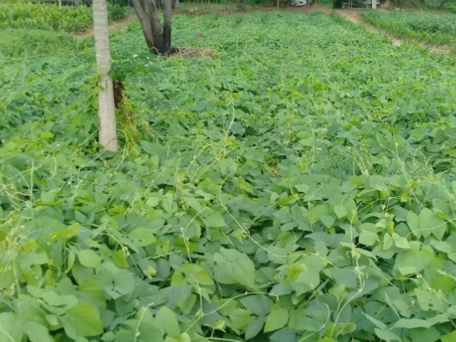
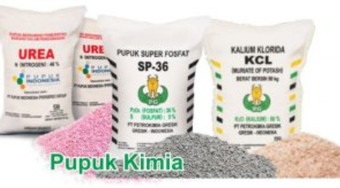
Nutrient sources
Organic matter
Chemical fertilizers
Manure
Crop residues (rice straw, corn stalk, palm frond, etc.)
Composts
Green manure
Legume cover crops
Bio-fertilizers
Urea
Ammonium sulphate (ZA) for calcareous soils
NPK
SP-36, TSP, Rock Phospate
KCl
Farmers’ knowledge of the role and application of these nutrient sources vary
Sometimes competitive use of organic manure off-farm

Slide 6
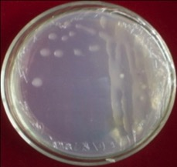
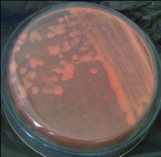
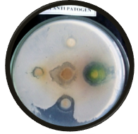
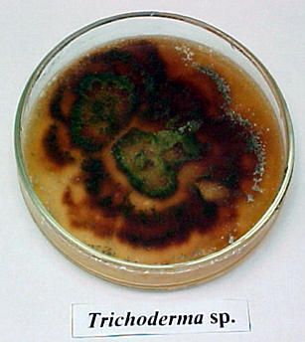
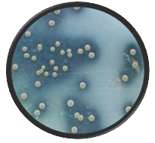
Increasing Roles of Biofertilizers
N-fixing bacteria → Reduce chemical N fertilizer application
P-Solubilizing microbes → Increase soil P availability, reduce P fertilizer requirement
Organic matter decomposers → Speed up composting, reduce C/N ratio, and reduce soil NO₃⁻ fixation
Plant growth promoters → increase root development and nutrient uptake
N-fixing
Anti pathogens
Organic matter decomposer
P-solubilizing

Slide 7
Improved Nutrient Management Strategies:
Co-Benefits and Synergies
Strategies | Benefits/Co-benefits
 | Adaptation | Co-benefits
Balanced fertilization and site specific recommendation: e.g. Soil Test Kits, Cropping calendar | Balanced nutrients requirement, increase fertilizer use efficiency, better crop vigor, more resistant to diseases, higher production, | Lower N₂O and lower CO₂ emissions, lower eutrophication and water pollution,
Integrated nutrient management: Combining all available (especially local) sources | Higher efficiency, better crop growth and production | Less leaching, lower water pollution, and lower indirect N₂O emission, more biodiverse soil biota
Higher use of organic matter | Improved soil physical, chemical and biological properties | Increased soil C stock, increase soil biota diversity

Slide 8
Improved Nutrient Management Strategies:
Co-Benefits and Synergies
Improved management systems | Benefits/Co-benefits
 | Adaptation | Co-benefits
Biofertilizer | Improved nutrient availability | Lower needs for chemical fertilizers
Soil conditioners (lime, organic matter, biochar, vermiculite, etc.) | Improved soil fertility for problem soils such as acid soils, peat soils, ex-mining areas: Increase soil pH, Increase CEC Neutralize toxic elements Improve soil structure | Increased crop growth and production, increase carbon storage, increase soil biodiversity

Slide 9
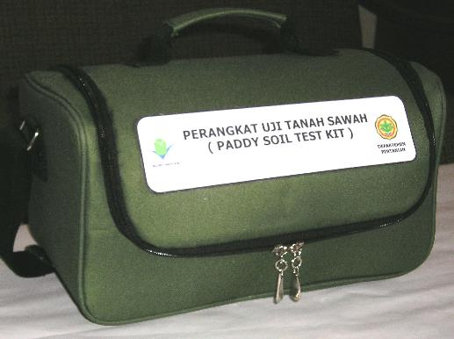
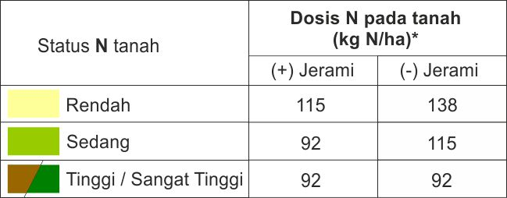
Soil Test Kit for Site specific fertilizer recommendation
Soil N, P, K, pH extractant,
Nutrient color chart
Leaf color chart for N
Fertilizer recommendation chart

Slide 10
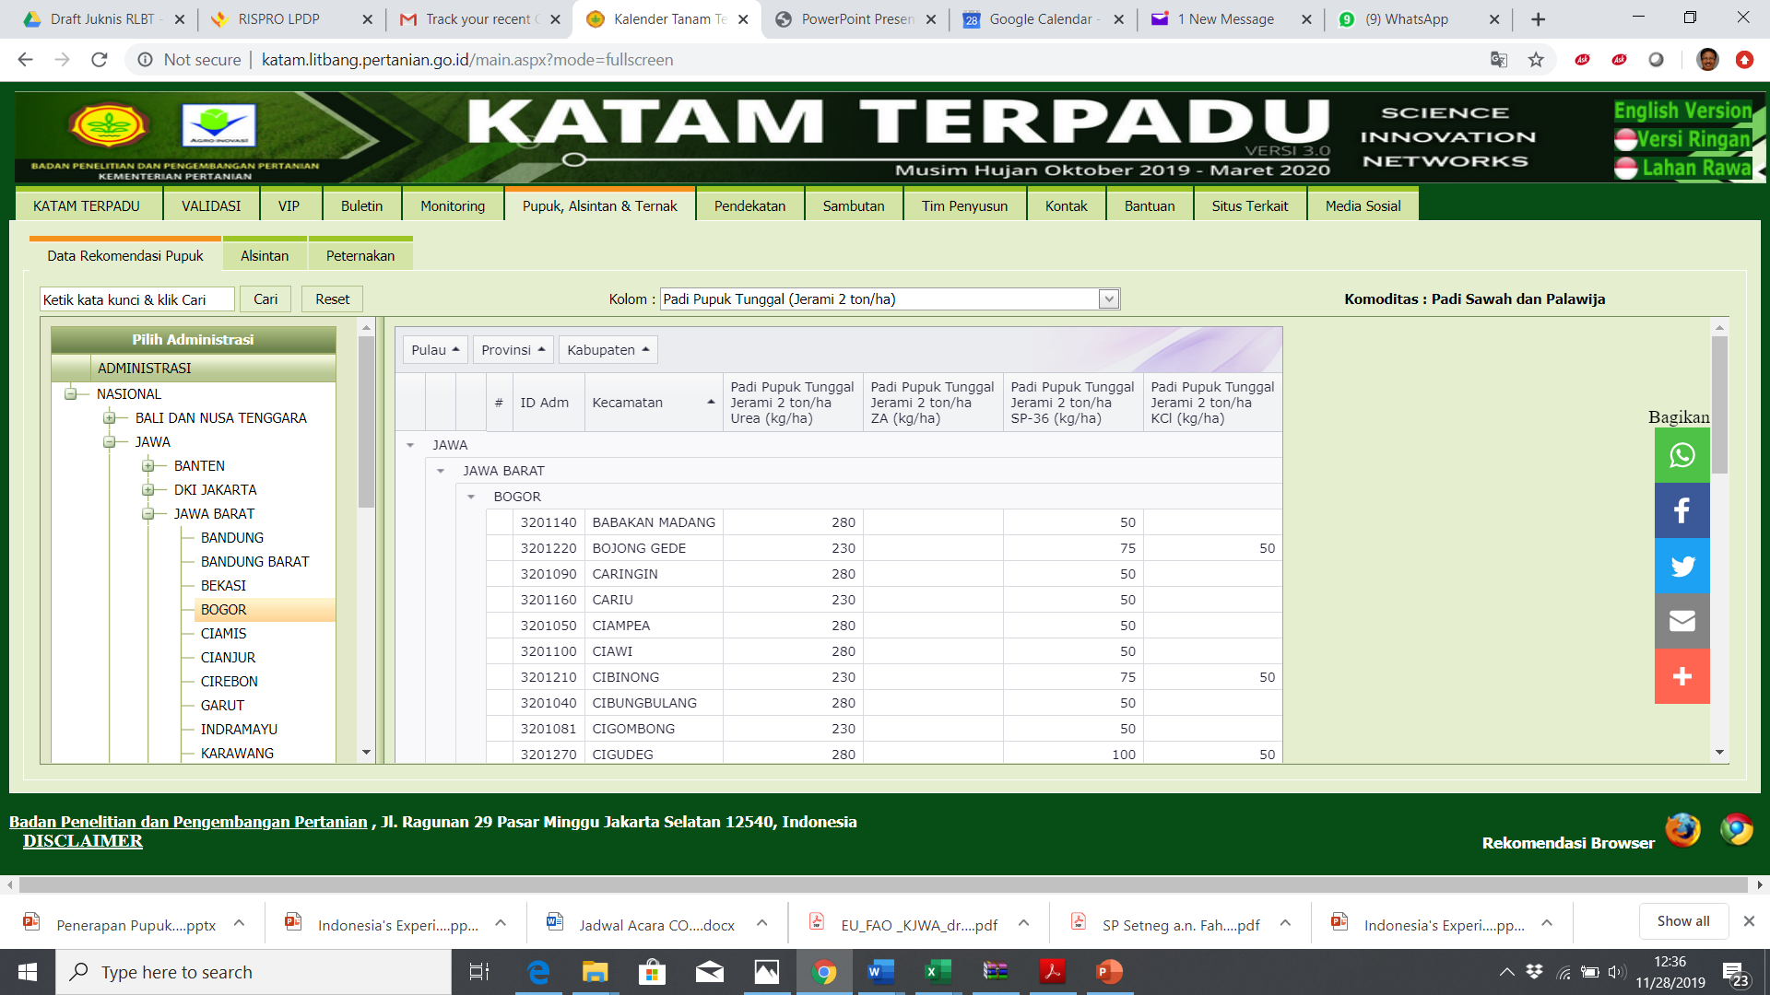
  Integrated Cropping Calendar katam.litbang.pertanian.go.id;
  From a cropping calendar, evolved to fertilizer & crop variety recommendations package for 6,982 Subdistricts

Slide 11
Animal husbandry
Livestock | Population in 2018 (k head) | Holding (head) | Manure management
Beef cattle | 17,050 | 1-hundreds | Solid storage, dry lot, daily spread, anaerobic digestion, composting
Dairy cattle | 550 | 1-hundreds | Solid storage, dry lot, daily spread, Anaerobic digestion, composting
Sheep | 17,398 | 5-100 | Dry lot, daily spread, composting
Goat | 18,721 | 5-100 | Dry lot, daily spread, composting
Poultry | 2,444,000 | 5-thousands | Dry lot, composting

Slide 12
Manure management Co-benefits
Management | Extent of practice | Benefits (adaptation) | Co-benefits
Liquid/Slurry, Pit storage | ** | Better distribution to the field | High CH₄ emission
Solid storage | **** | Better distribution | Low GHG emission
Dry lot | *** | Better distribution | Low GHG emission
Daily spread (grazing) | **** | Uneven distribution | Easy management, low emissions
Anaerobic Digestion | * | Expensive investment, high labor | Source of renewable energy
Composting | *** | Better nutrient availability | Low GHG emissions

Slide 13
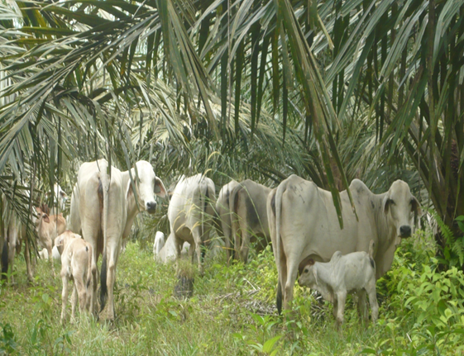
Examples of improved systems
Crops – Livestock Integration
Residues as feed
Food Crops: rice, maize
Perennial crops: palm oil, rubber, coffee, cocoa, sugarcane
Ruminant: cattle, buffalo, goat and sheep
Poultry: duck, local chicken
Manure and urine

Slide 14
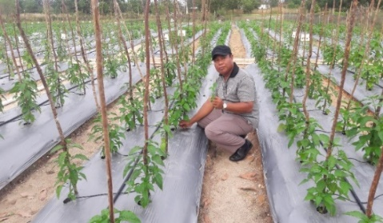
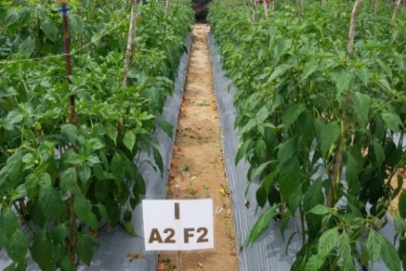
Fertigation (especially for sandy soils and water scarcity areas)

Slide 15
Closing yield gap, e.g. for oil palm plantation
Type of plantation | Area | Current FFB Yield | Attainable FFB yld | Exploitable Yld | Extra FFB prodxn potential | Land saving
 | (Million ha) | t/(ha.yr) | t/(ha.yr) | % of attainable yld | Million t | million ha
Large plantations (59%) | 5.8 | 19.7 | 31.8 | 38 | 70 | 3.55
Smallholders (41%) | 4.1 | 15.3 | 28.9 | 47 | 55 | 3.59
Indonesia | 9.9 | 17.9 | 30.9 | 42 | 125 | 6.98
If we can increase yield to 70-80% of potential yield:
We can produce extra 125 Mt extra FFB (about 25 Mt CPO)
Increase farmers income
Avoid about 7 Mha OP plantation expansion
Significantly reduce GHG emissions

Slide 16
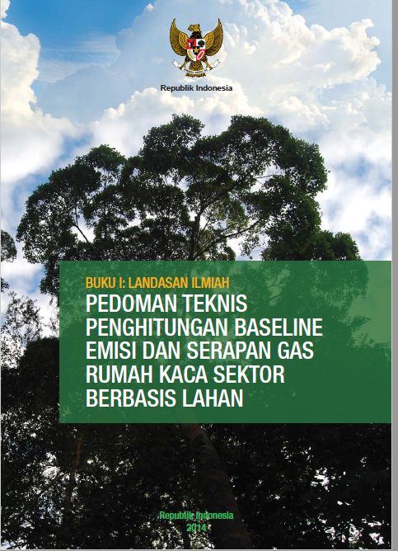
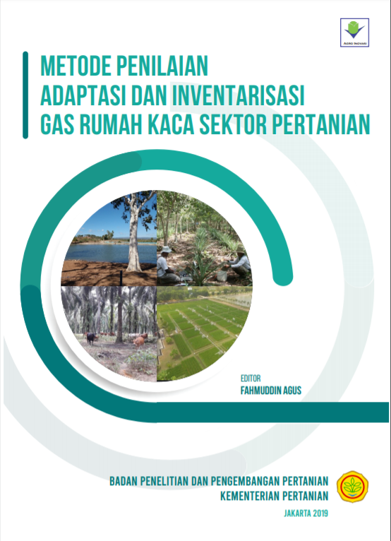
Goals and assessment
The goal is maintenance of food security and increasing farmers’ income
We will include adaptation and co-benefit assessment in our next reporting

Slide 17
Challenges and Future Needs
How to speed up and scale up the implementation
Capacity building, especially for remote and resource poor farmers.
Regional scale pilots to develop, implement and evaluate improved nutrient and manure management
Technology exchange, not only between Annex 1 and Non-Annex 1 countries, but also among Non Annex 1 countries
Other means of implementations

