Slide 1
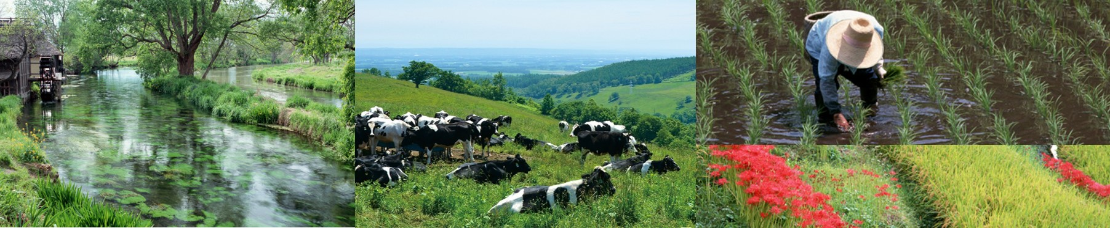



Japan’s work on activities related to improving nutrient use and manure management towards sustainable and resilient agricultural systems
December 3, 2019 Koronivia workshop on 2(d) , Madrid
Akiko Nagano, Environment Policy Office, MAFF
Taro Izumi, Japan International Research Center for Agricultural Sciences

Slide 2
Outline
Guiding questions
Country experiences
Co-benefits and synergies with multiple objectives (incl. SDGs)
Setting goals
Challenges and how KJWA and constituting bodies can help
Japan’s experience I. Technical activities for improved fertilizer use efficiency and increased productivity
Challenges and expectation to the Koronivia joint work on agriculture and UNFCCC constituted bodies
Japan’s experience II. Social awareness raising

Slide 3
1. Technical activities
General background
AFOLU activities accounts for 82% of nitrous oxide emissions from human activities (2007-2016). IPCC Special Report on Climate Change and Land, 2019
Nutrient use and manure management and associated greenhouse gasses are related with many elements (e.g. crop yield and quality, N and C dynamics in soil)
Improved nitrogen use efficiency is often related to multiple benefits (e.g. reduced cost/yield, reduced leaching, possibly also with biodiversity)

Slide 4
1. Technical activities
Examples of research
Model-based visualization tool for agricultural soil carbon sequestration and GHG emissions
Biological nitrification inhibition (BNI)
Promotion of Smart Agriculture

Slide 5
Need to evaluate the total Global Warming Potential (GWP)
Possible trade off：Management practice to increase soil carbon may increase emissions of other GHGs
e.g. Mitigation option: “Increase C inputs to soils”
Soil C increase
(CO₂ decrease)
CH₄ and N₂O increase
Trade-off
Total GWP?
Source: Dr. Shirato, NARO, Agriculture is the solution! workshop, May 2019, Shiga

Slide 6
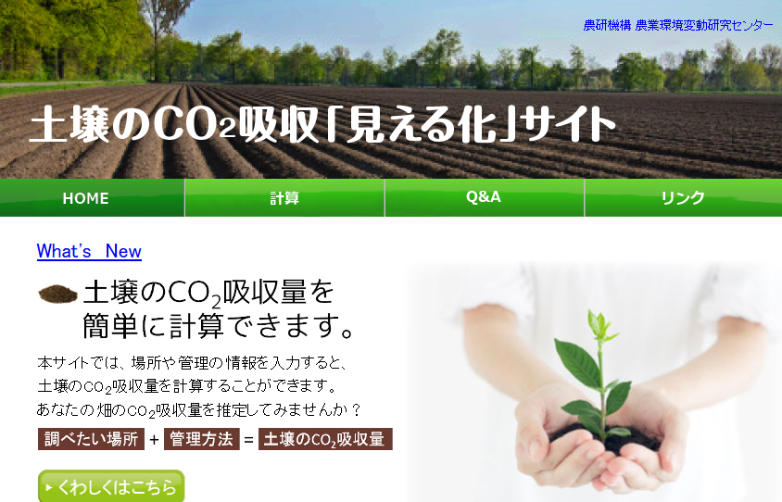
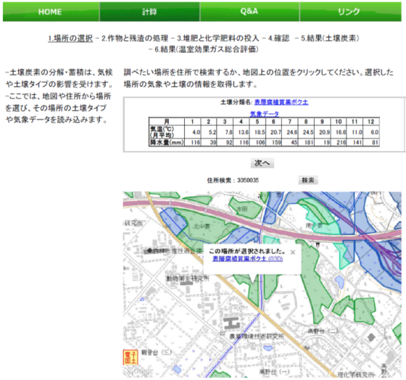
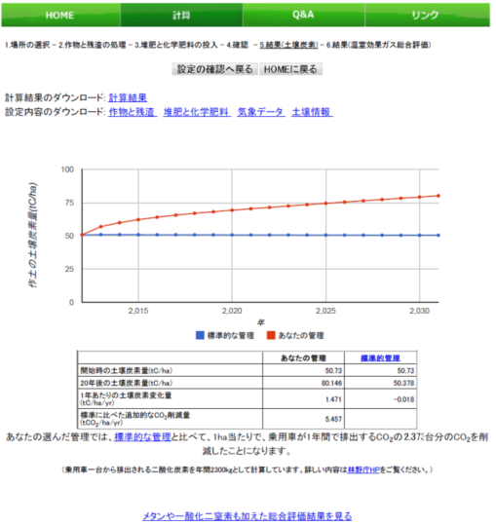
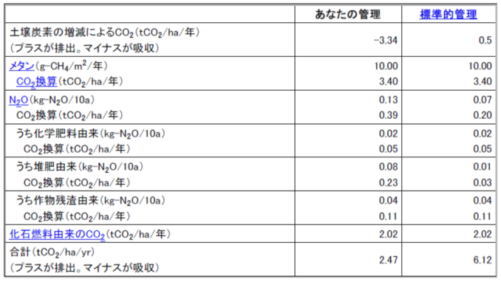
Web-based visualization tool for agricultural soil carbon sequestration and GHGs emission
Click on map ➔ get weather and soil data
Select crop and management
Simple and easy interface
➔ Show results of changes in soil carbon
Total evaluation of 3 greenhouse gases (CO₂, CH₄, N₂O)
Source: Dr. Shirato, NARO, Agriculture is the solution! workshop, May 2019, Shiga

Slide 7
The concept and function of Biological Nitrification Inhibition (BNI)
Rapid nitrification results in inefficient N-use by crops, leading to environmental pollution. BNI is an active plant-mediated natural function, where nitrification inhibitory substances released from plant roots suppress the soil-nitrifying process.
GHG
Fertilization
(Nitrogen fertilizer）
N₂O
Absorption
Denitrification
NH₄⁺
Pollution of the terrestrial environment
Nitrification
BNI substance
Leaching
NO₃⁻
Absorption

Slide 8
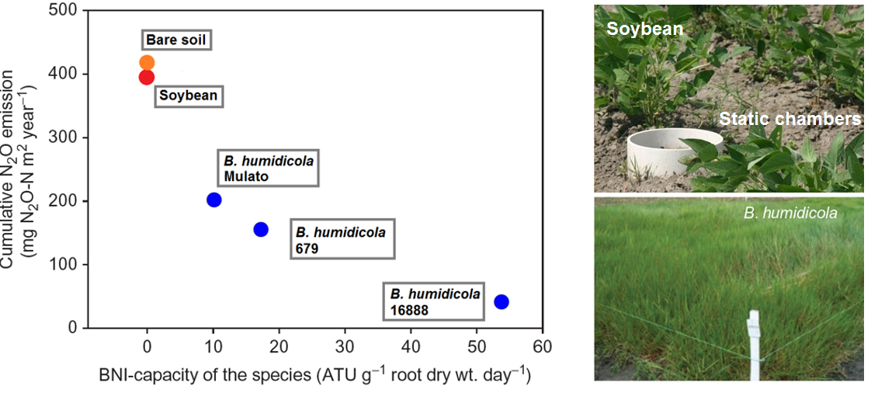
Evidence of benefits (Environment)
N₂O emission negatively correlates with the activity of BNI secretion from the species planted (adapted from Subbarao et al., 2012).

Slide 9
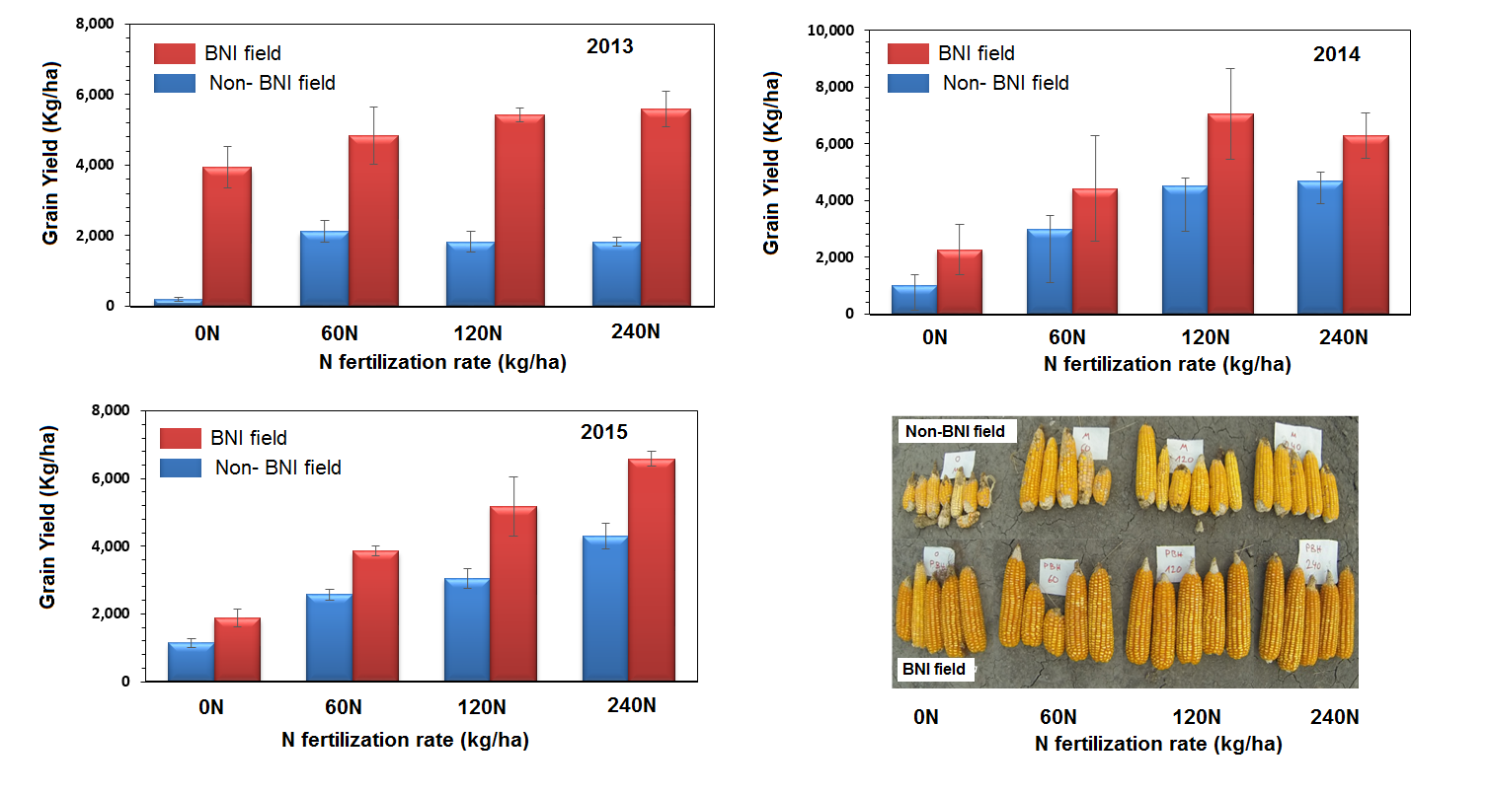
Evidence of benefits (Agriculture)
Corn grain yield in fields with previous land use of Brachiaria (BNI field) and crops (non- BNI field). Data and image are provided by Dr. Jacobo Arango, CIAT, Colombia.

Slide 10
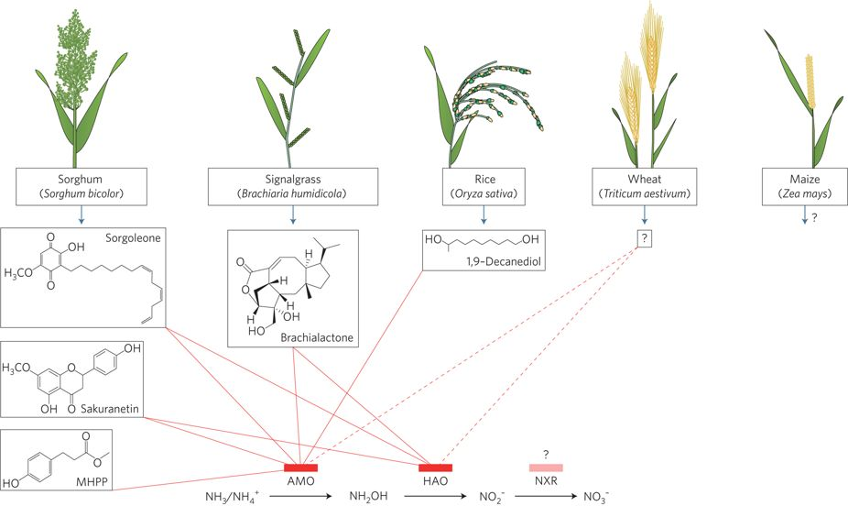
The BNI technology
Primarily discovered the phenomenon by Japanese scientists in Latin America.
A lot of efforts have been paid by JIRCAS and collaborators for the scientific recognition of the existence and significance of BNI.
Modified from Coskun et al., 2017
Breeding efforts for high BNI with use of wild relative Leymus
Doubled haploid sorghum populations being made from high- and low-BNI cultivars to elucidate the BNI-responsible gene(s)
High-BNI maize lines being selected from genetic resources of CIMMYT collection

Slide 11

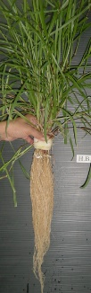



Development of cultivation management system to reduce greenhouse gas derived from agriculture
MAFF-CIAT project, 2018-
Monitoring and analysis of environment, on-farm management and growth
AI and IoT technology
management based on data
Increased productivity on degraded pasture
Reduced N₂O emission
High-BNI capacity grass
Introduce to degraded pasture
High-BNI capacity pasture

Slide 12
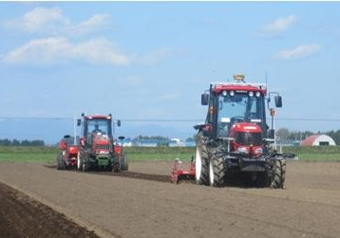
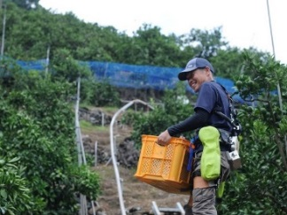
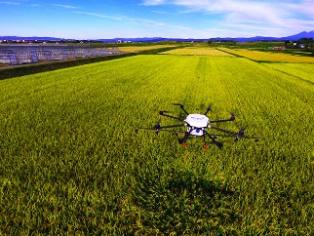


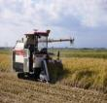




Smart Agriculture
Advantage of agriculture of Japan
advanced technologies
・ Expert skills corresponding to local characteristics such as climate and soil
・ Delicious breeds and brands with wide variety reflecting local characteristics around Japan
・ Safe and secure agriculture products matching with consumers’ needs
Robot tractor
Assist suit
Drone
40% reduction of
working time
Only a half of the usual power is required in lifting operation
Optimized manuring and pest control based on sensing data of the whole field
“Agriculture Technology” × “Advanced Technology”
Expert
farmer
Converting to formal knowledge by ICT technology
Beginner
Smart Agriculture
Wrong
Right
Right
Unmanned operation system
Consideration
Right
Wrong
Fruits thinned by experts
Utilized in study and teaching for new farmers
Effects of Smart Agriculture
・ Automation of operation by advanced technologies such as robot tractors and water-management system operated by smartphones enables scale-up of business.
・ ICT technologies enables succession of agricultural skills of expert farmers to young farmers.
・ Highly managed agriculture will be realized by accurate prediction of growth and diseases to utilize and analyze sensing data, etc.

Slide 13


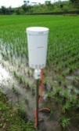


Development of Agriculture by Making Full Use of the Data - Agricultural Data Collaboration Platform “WAGRI” -
For everyone involved in agriculture to be able make a good use of data for better productivity and management, ICT vendors, agricultural machinery manufacturers, and research institutes start to use ”The agricultural data collaboration platform (WAGRI)“.
Current status and tasks
the agricultural data collaboration platform “WAGRI”
Agricultural ICT services in Japan
Functions
【Basic structure 】
Farmers, etc.
Most of public data is scattered and not suitable for ICT use
Coordination
It will enable different vendors and manufacturers to share data on various ICTs, agricultural machinery, and sensors.
Agricultural machinery manufactureＡ
Agricultural machinery manufactureＢ
ICT vendor Ｃ
ICT vendorＤ
Weather
data
Soil data
Private data
(Closed data)
individuals store and manage their own data in safe manners.
The agricultural data
collaboration platform
Market data
Cultivation
data
Sharing
Public data
To provide various data such as weather, land or map (may be charged.)
Data sharing will create new services that will lead to data comparison and better productivity.
It is bothersome when data that you want to use are scattered across different places.
Weather
API
Land
API
Map
API
Sensor
API
Growth
Prediction API
Soil
API
Stats
API
Master data
Provide processed data of public’s and private’s raw data.
Providing
It enables to provide useful data for farmers such as soil, weather and market.
Private
business
Private
business
Private
business
Private
business
Private
business
Authentication system
Use Open ID Connect.
Researcher
(NARO)
Government
<Effects of “WAGRI”>
Climate data
Market data
Map data
【An effect of
data collaboration】
【An effect of
open data utilization】
Various open data can be organized on the agricultural data collaboration platform ready to be used by anyone.
It increases yield and quality of products, by data aggregation and analysis.
Yield data
Cultivation History
Various open data will be provided on the agricultural data collaboration platform, which will help farmers make strategic management decisions.
Material data
Cultivar
/cultivation data
The agricultural data
collaboration platform
The agricultural data
collaboration platform
Aggregate and analyze data
Water level/
temperature data
According to the market and weather data, it looks like it would be more profitable to sell to the market B rather than to market A!
Soil data
4

Slide 14
2. Challenges and how KJWA and the UNFCCC Constituted bodies can help
  Implementation of best practices, innovations and technologies in farmers’ fields
  Inter-disciplinary collaboration
  Communicating science to users and beneficiaries of the technologies (e.g. farmers, consumers, national and local policy makers)
KJWA and UNFCCC bodies can advance work by connecting science to the broader community and national tools

Slide 15
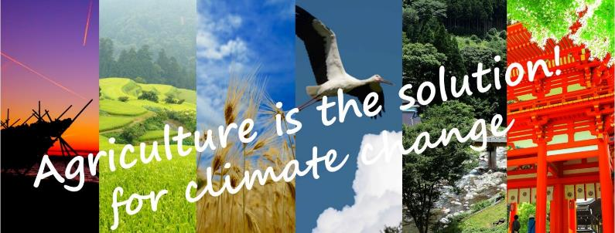
3. Social awareness activities
International symposiums held in Japan (2019)
Agriculture is the Solution! for Climate Change
Scaling up and out climate-smart technologies and practices for sustainable agriculture “Climate change and agriculture business”

Slide 16
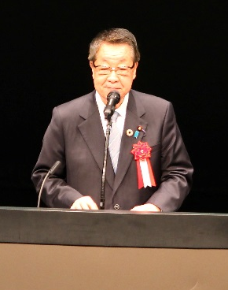
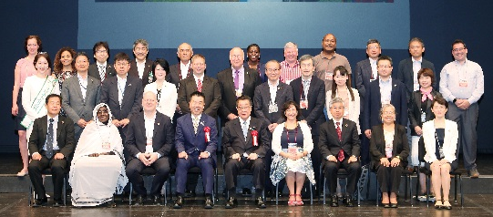
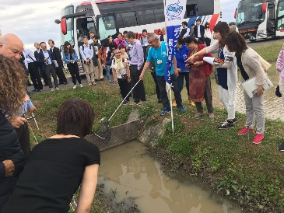
Agriculture is the Solution! for climate change
International symposium, May 2019 in Shiga, Japan
All participants highlighted the extreme vulnerability of agriculture to climate change and the urgency of accelerating action before it is too late.
Key messages
Multi-stakeholders exchanges are fundamental for inclusive decision making and successful uptake of actions on the ground.
Farmers are at the center of addressing climate change and are key to scaling up proven solutions.
Consumers, governments and all stakeholders in this common challenge must recognize the valuable role of farmers.
The symposium was organized by MAFF with support from Shiga Prefecture, the Food and Agriculture Organization, the World Bank and the 4per1000 initiative.
Opening by H.E. Minister Takamori Yoshikawa
Field trip
Program and presentations available at
http://www.maff.go.jp/e/policies/env/agsol.html

Slide 17
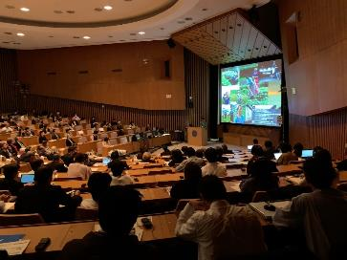
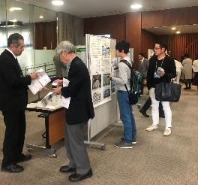
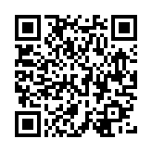
Scaling up and out of climate-smart technologies and practices for sustainable agriculture
Climate Change and Agriculture Business
International symposium, November 5, Tokyo
MAFF Japan also organized a symposium for scaling up and out climate-smart technologies and practices, as part of the follow-up international workshop of G20 Meeting of Agriculture Chief Scientists (April 2019, Tokyo).
← Website
of the symposium
(http://www.maff.go.jp/j/kanbo/kankyo/seisaku/kikouhendou/symposium/cs.html)

Slide 18
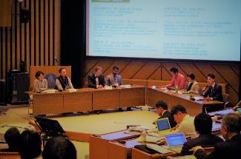
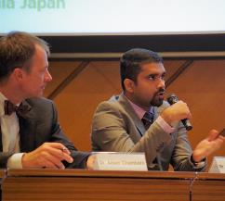
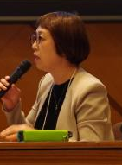
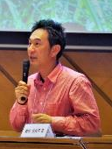
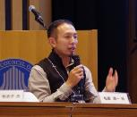
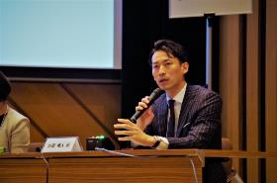
“Scaling up and out of climate-smart technologies and practices for sustainable agriculture”
Panel discussion “Let’s discuss seriously for our future”
International symposium, November 5, Tokyo
farmers
Research community
Farmers’ voices
Private sector
We feel the crisis – plant diseases, extreme weather events, etc…
Farmers care about climate change, but didn’t know what was happening at global scale. Even if they intend to do good thing, they might burden the environment, because sometimes they don’t have scientific knowledge.
Farmers bear the operational risk when installing new equipment and machinery to introduce new practice.

