Slide 1
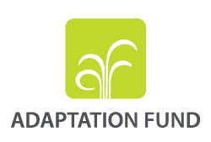
Improved Nutrient Use and Manure Management towards Sustainable and Resilient Agricultural Systems
Koronivia joint work on agriculture
3 December 2019
Mahamat Assouyouti, Sr Climate Change Specialist

Slide 2
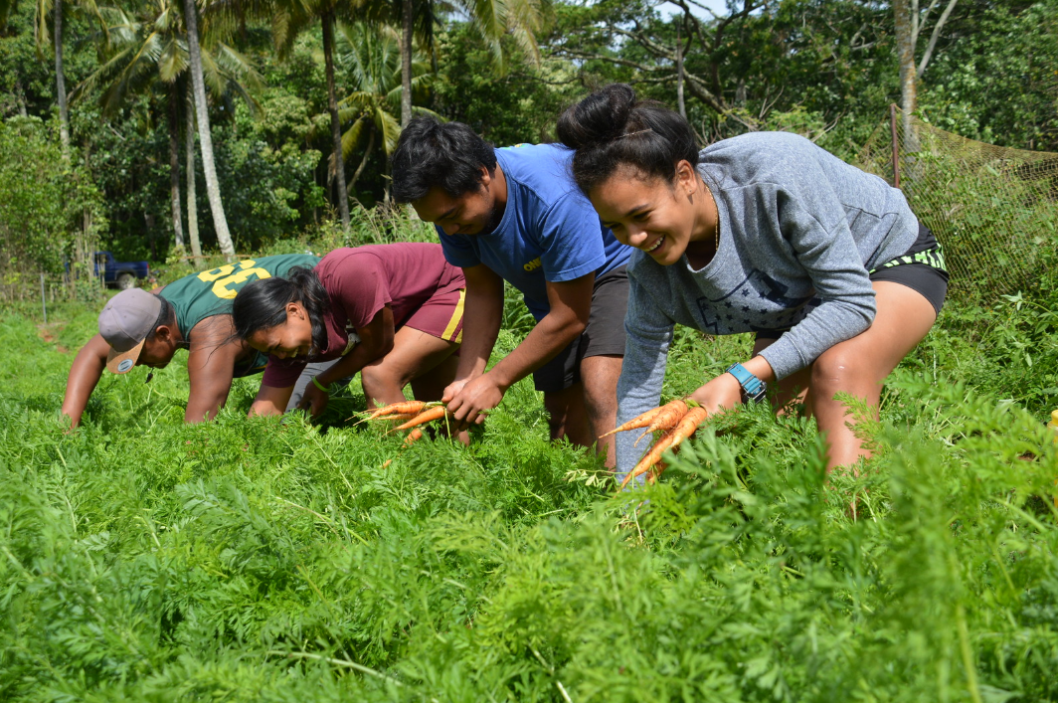
Key achievements of the Adaptation Fund
100 concrete adaptation projects for total US$720 Million
98 countries incl. 18 SIDS and 30 LDCs
Serves the Paris Agreement since Jan 1 2019
US$248 Million of active pipeline (Nov 2019)
8.7 million direct beneficiaries
49 Implementing entities incl. 31 NIEs
Pioneer of the direct access modality
US$200 Million in agric. and food security

Slide 3
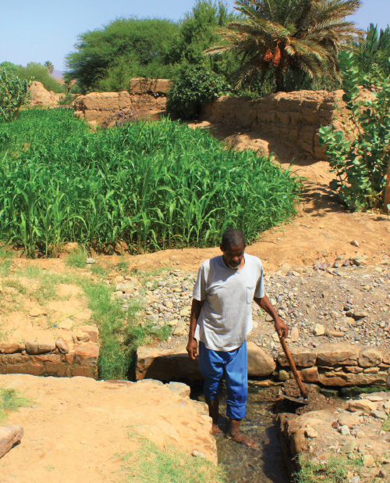
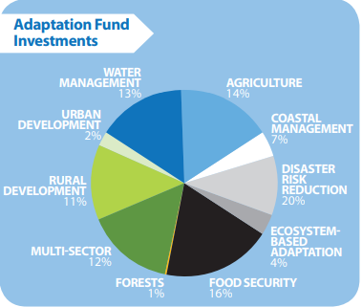
A diversified portfolio incl. Agriculture and Food Security
About 1/3 portfolio covers agriculture development and food security for more than $200 million invested
Africa (36%); Asia Pacific (34%) and Latin America and Caribbean (30%)
Concrete adaptation actions including Climate Smart Agriculture, SLM, enabling environment, food security, conservation agriculture, etc.
Funding on the basis of the full cost of adaptation (No co-financing required, addressing adaptation needs and co-benefits if any, no BAU)
Environmental, socio-economic benefits especially for the most vulnerable and gender considerations
Figures as of September 30 2019

Slide 4
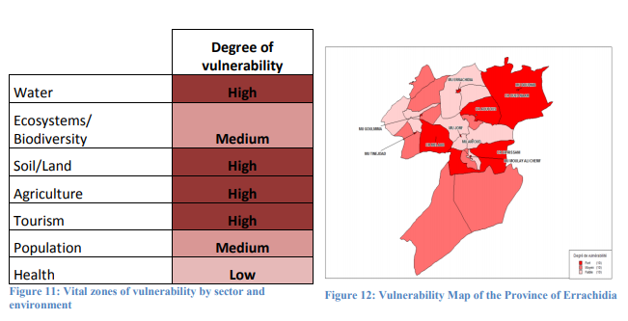
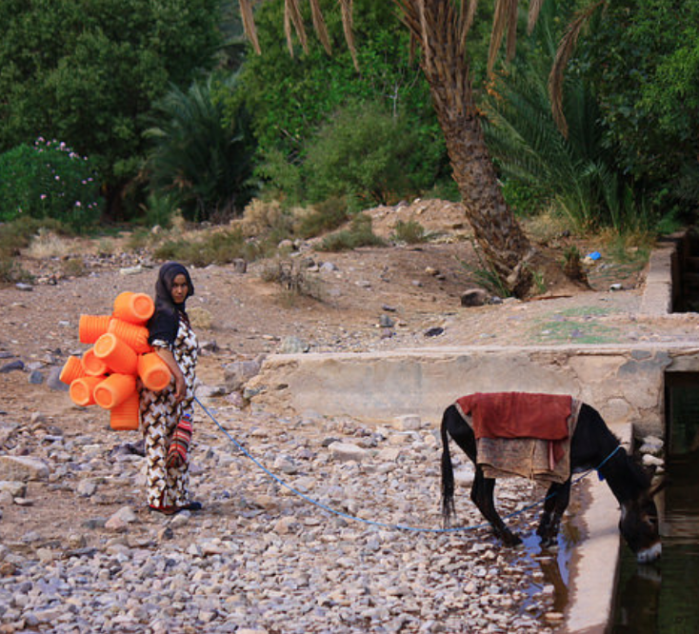
Morocco - Climate Change Adaptation in Oasis Zones (PACC-ZO)
Implementing Entity: Agence pour le Développement Agricole
Financing amount: US$ 9,970,000
Objective : Enhancing grasslands, shade trees and animal management
Specific techniques involve biological control, crop rotation and composting.
Resilience of the oasis agro-system is based on the maintenance of specific crops, coupled with a system of animal husbandry integrated with the oasis agriculture, including manure production. In addition, the project aims to improve livelihoods of families due to the development of more resilient small scale agriculture
Key outcomes:
400 families to adopt conservation agriculture and small scale resilient agricultures
800 farmers trained in conservation technics and corps diversification
70% efficiency in agriculture irrigation and productivity using composting

Slide 5
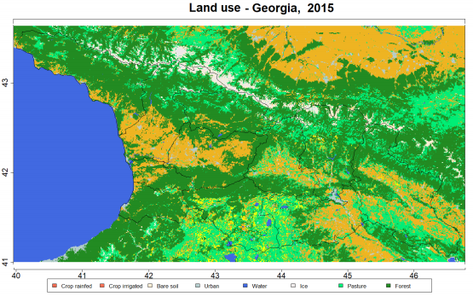
Georgia - Dairy Modernization and Market Access - DiMMAdapt
Implementing Entity: International Fund for Agricultural Development
Financing amount: US$ 4,644,794
Objective : The project aims to implement climate resilient and DRR solutions for pasture rehabilitation and increased productivity for over 6,000 farmers
Specific techniques improved fodder varieties, collective pasture management techniques, and manure composting to minimize waste and prevent soil and nearby water pollution.
Climate proofing of investments through demonstrations targeted at the Pasture User Associations (PUAs), smallholder and progressive farmers; community-based Pasture Management Plants (PMP’s) integrating CCA and DRR measures.
Source : Strategy for Agricultural Development (SAD) in Georgia for 2015-2020
Key outcomes:
9,500 ha of pastures rehabilitated or restored;
76 PUA’s to receive capacity building in pasture management;
3,900 households supported with Climate resilient and ecosystem-based adaptive pastoral investments

Slide 6
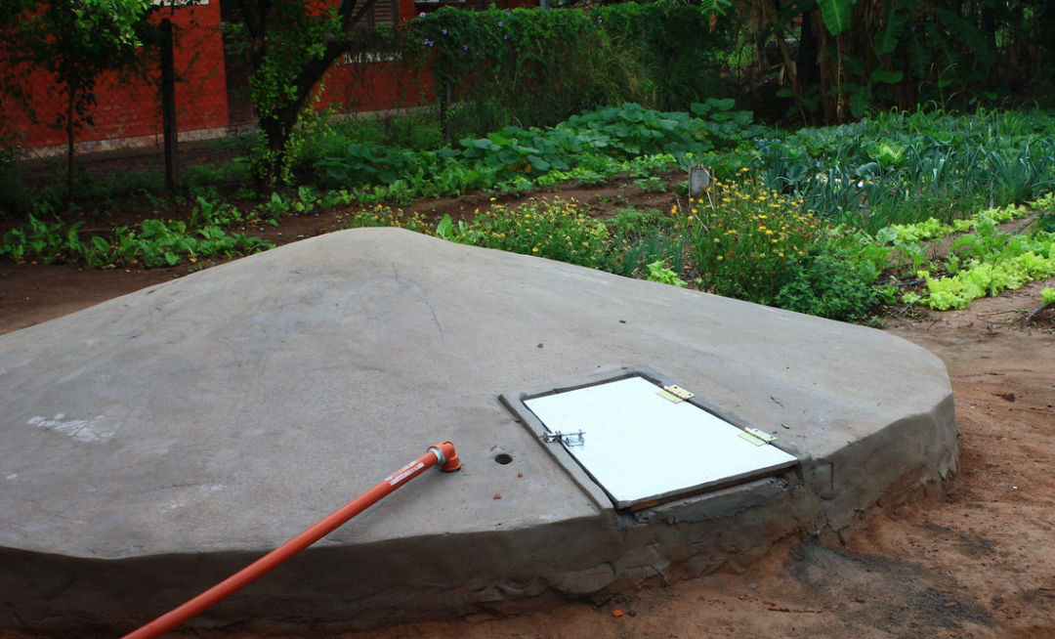
Enhancing the Adaptive Capacity and Increasing Resilience of Small-size Agricultural Producers of the Northeast of Argentina
Implementing Entity: Dirección General de Programas y Proyectos Sectoriales y Especiales
Financing amount: US$ 5,640,000
Objective : The project aims to implement soil management techniques by means of incorporation and management of cover crops and green manure
Specific techniques : Cover crops and green manure are jointly implemented to increase existing moisture and to incorporate more organic matter into the soil.
Promotion of community resilience to climate change through SLM and agro-forestry : Implementation of soil management techniques by means of contour ploughing and/or the incorporation and management of cover crops and green manure
Key outcomes:
At least 4,000 families with increased adaptive capacity and resilience of small-scale family agricultural producers
138 boreholes drilled by the end of the project
140 multipurpose water supply systems built (human consumption, animal watering and irrigation of orchards, fruit trees and pasture)

Slide 7
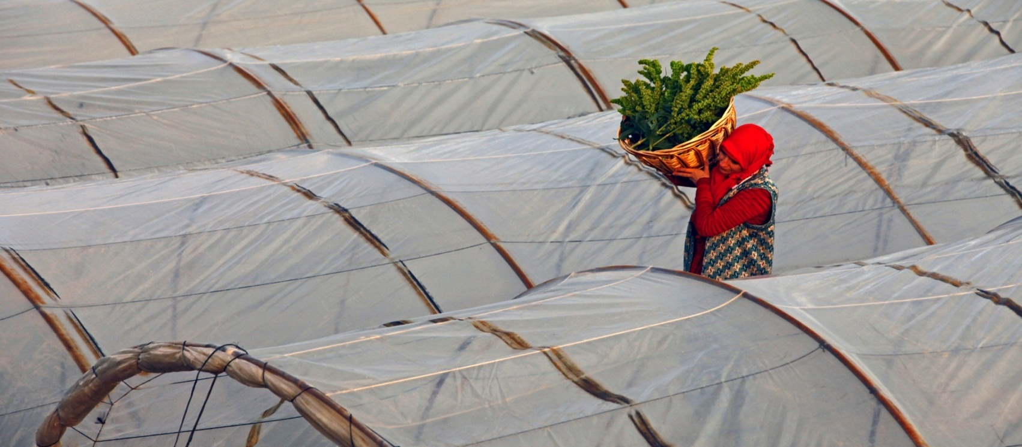


Thank you!
www.adaptation-fund.org
afbsec@adaptation-fund.org
adaptationfund
@adaptationfund
Mahamat Assouyouti
massouyouti@adaptation-fund.org

