Slide 1
Financing sustainable and resilient agriculture
Janie Rioux, Senior Agriculture and Food Security Specialist, Division of Mitigation and Adaptation
Koronivia workshop on “Improved nutrient use and manure management towards sustainable and resilient agricultural systems”
COP25, Madrid, 3 December 2019
Notes:
experiences of GCF of maximum 10 minutes to update workshop participants on activities related to improving nutrient use and manure management towards sustainable and resilient agricultural systems.

Slide 2
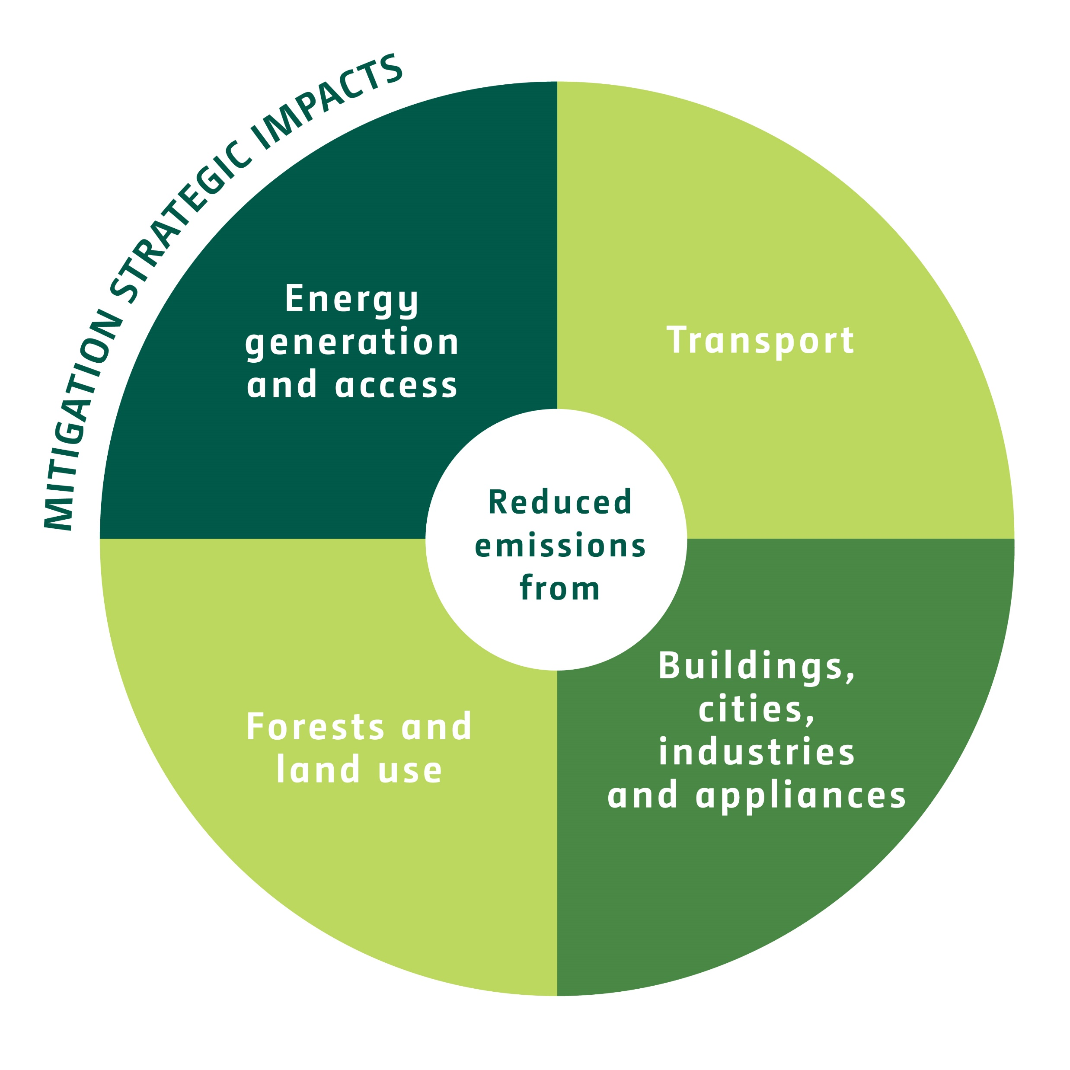
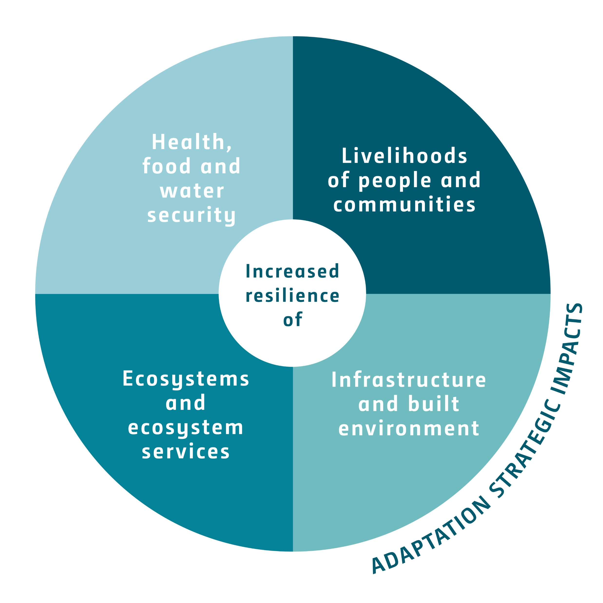
Investments areas related to sustainable & resilient agricultural systems
Mitigation
Adaptation
✓
✓
✓
✓
✓
✓

Slide 3
Current Portfolio related to agriculture
1.1 Billion in GCF funding (20% of 5.6B)
Number of projects
Financial instruments (%)
39
16
16
Approved
Under
implementation
Receiving
disbursement(s)
Expected impacts
75 M tCO₂ eq.
73 M beneficiaries
(B.24, 2019)

Slide 4
EXAMPLES of Project activities improving NUTRIENT USE
CROP LAND
Zambia (UNDP): Strengthening climate resilience of agricultural livelihoods
Conservation agriculture (no tillage), leguminous cover cropping, intercropping and crop rotation increasing soils nutrient and water retention
Trainings of farmers through FFS on resilient agricultural practices
1M people expected to become more resilient
Kyrgyzstan (FAO): Carbon Sequestration through Climate Investment in Forests and Rangelands
Pasture rehabilitation, and rotational grazing increasing productivity and carbon sequestration
Tenure arrangements for rangeland management
Monitoring of rangelands through remote sensing and field methods
14.9 m tCO₂eq as mitigation benefit in 20 years
GCF 32M
Co-financing 105M
PASTURE LAND
GCF 30M
Co-financing 20M

Slide 5
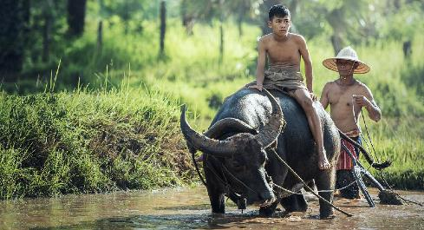
Example of Project activities improving MANURE MANAGEMENT
CAMBODIA (ADB): Climate-Friendly Agribusiness Value Chains Sector
Reducing greenhouse gas emissions and climate vulnerability of Cambodia's agricultural value chains.
Biogas produced using agricultural wastes and manure, as part of National Biodigester Prog.
Health benefits for 12,000 households
Improved nutrition through vegetables production using bio-slurry as fertilizer
Reduced emissions from i) replacement of wood with biogas for cooking, and ii) methane through improved manure management
GCF 40 M
Co-financing 100M

Slide 6
Measuring progress and challenges
Environmental and social safeguards will be monitor through the ESMF/P during project implementation.
Most projects will measure the increase in yield and income resulting from the sustainable and resilient agricultural practices, but fewer will measure change in soils health, water retention, and biomass change, or emissions reduction from manure mgt.
Overall projects are integrated within landscapes and along value chains, include water management and climate information, and are focusing on the impacts on people livelihoods and food systems.
Important to address barriers to adoption to ensure long term sustainability and paradigm shift.

Slide 7
Opportunities for koronivia
GCF is country driven and aims to turn country ambitions into climate actions, based on country NDCs.
GCF Readiness Programme can finance capacity building, studies, inter-sectoral and multi-stakeholders consultations.
GCF Project Preparation can finance data collection and analysis.
Climate investments (projects and programmes) can include:
Policies reform or implementation and incentive schemes
Innovative low emissions and resilient approaches and technologies
Monitoring and evaluation methods and MRV system

Slide 8
Thank you for your attention
Janie Rioux
jrioux@gcfund.org

