Slide 1
Improving nutrient use and manure management for sustainable and resilient agricultural systems
Martien van Nieuwkoop,
Global Director, Agriculture & Food
The World Bank

Slide 2
KEY MESSAGES
Global efficiency of added nutrients to soils through organic and synthetic fertilizers is only about 50% leading to 12% of total Emissions from Agriculture and aquatic pollution.
Better nutrient efficiency through better fertilizer application, manure management and recycling of nutrients will contribute to making low-input more productive and high-input systems less emissions intense.
.
Proven management practices that increase nutrient efficiency exist. However, more work is needed to enable these practices to be implemented at scale.
KEY ACTION AREAS
Increasing public awareness & technical assistance; Realigning policies and financial mechanisms to incentivize nutrient and manure management planning; Improving soil data quality & Monitoring, Reporting and Verification.

Slide 3
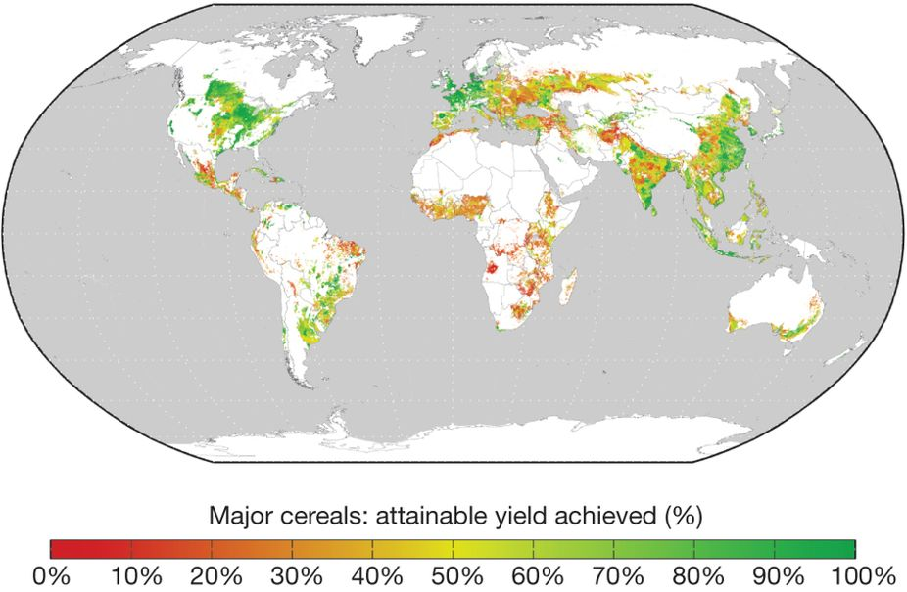
Better nutrient management for raising yields and decreasing greenhouse gases needed
Improving nutrient use efficiency may increase production by up to 70% for most crops – and contribute significantly to closing global yield gaps.
ND Mueller et al. Nature 000, 1-4 (2012) doi:10.1038/nature11420

Slide 4
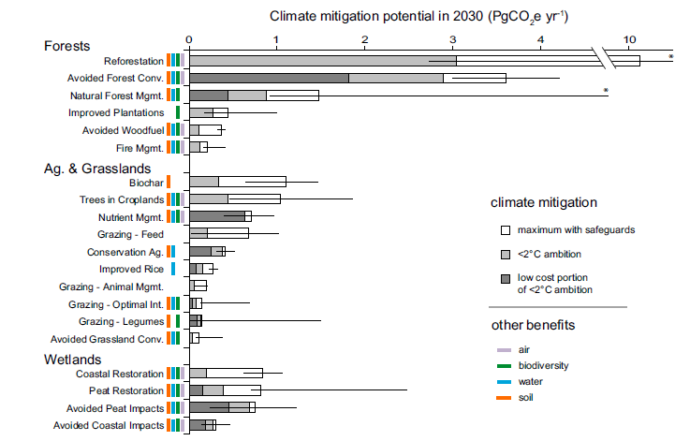
Improving nutrient use efficiency could mitigate 0.71 GtCO2e annually by 2030
Griscom et. al 2017

Slide 5

Three priority action areas to advance the nutrient and manure management agenda
To promote the nutrient and manure management agenda, we propose three priority action areas:
Priority #1: Making nutrient and manure management a priority in NDCs
Priority #2: Realigning public and private support for improving nutrient and manure management
Priority #3: Improving Monitoring, Reporting and Verification (MRV) for nutrient and manure management

Slide 6
Priority #1: Making nutrient and manure management a priority in NDCs
  Less than 25% of countries focused on mitigation commitments directly related to both fertilizer (43 countries) and manure management (46 countries)
  Technical assistance is needed to support countries to define and/or raise the ambition of nutrient management targets in their NDCs as well as to capture and disseminate the (co-)benefits of the improved nutrient use efficiency achieved
  Country updates to NDCs will be important entry points for providing technical support and awareness-raising
KJWA could focus on:
Encouraging technical agencies to issue guidance for including nutrient management aspects into NDCs
Promoting the prevention of soil degradation as a key intervention
Enable NDC Partnership to provide nutrient management related support to help countries to implement their NDCs

Slide 7
Priority #2: Realigning public and private support for improving nutrient and manure management
More work is needed to identify global hot spots for nutrient management as well as to realign public and private support for delivering public-good outcomes that promote nutrient use efficiency. Promising strategies include:
  Improving soil data quality and availability to farmers
  Tailoring regulations, incentives, and outreach to local conditions as there is no blueprint
  Improving extension and knowledge transfer systems
KJWA could focus on:
Developing a policy brief under the Technology Executive Committee (TEC)13 on designing policy reforms to reduce distortions in public support programs related to nutrient management
Drafting inputs to Green Climate Fund (GCF) strategy development to identify hot spots and leverage public and private investments toward improving nutrient management in hot spot areas

Slide 8
Priority #3: Improving Monitoring, Reporting and Verification (MRV) for nutrient and manure management
  Assessments of fertilizer-derived emissions and the accuracy of mitigation protocols needs to be improved
  MRV related compliance cost needs to be lowered
→ A standardized, accurate and low cost approach to MRV for assessing nutrient use efficiency in the context of productivity and emission trade-offs would provide a significant rationale for the use of public funds in support of improving nutrient and manure management
KJWA could focus on:
Mobilizing requests from countries for support under the Climate Technology Centre and Network (CTCN)16 for
  Tools and methodologies for MRV on nutrient management
  Global guidelines for fertilizer use

Slide 9
Soil management and manure management often go hand in hand
Project Example: Uruguay - Sustainable management of natural resources and climate change (DACC)
Objective & Means
  To support Uruguay's efforts to promote farmer adoption of climate-smart agricultural and livestock practices, and improved natural resource management practices in project areas
  Establishment of an Agricultural Information and Decision Support System
  On Farm CSA-Investments and Livestock Management
  Capacity Building and Training
  Crop rotation and ground cover to minimize erosion and land degradation
  Regulated use of agrochemicals, including monitoring of applications, to reduce emissions from main agricultural systems
  Minimize and collect all effluent waste
Soil and manure management approaches
  Soil Management Use Plans for sustainable land use practices
  Sustainable Intensification of Livestock Sector
  2,509,000 hectares of land are under sustainable land management practices
  36% increase in adaptive capacity, measured by a vulnerability matrix at department level including socio-economic, biophysical, and technical indicators
  DACC on-farm investment in CSA has supported 5,139 farmers to increase energy efficiency, soil management capacity and dairy production
Impacts

Slide 10

Integrated soil nutrient management as part of integrated CSA projects
Recently launched: China - Climate Smart Staple Crop Production Project
Objective
  To reduce GHG emissions in crop production, by improving efficiency of agricultural inputs (e.g. fertilizer, pesticides, irrigation water and agriculture machinery) and by promoting smart climate crop production systems
Integrated of package of CSA technologies – resulting in strong soil benefits
  Application of formula fertilizer and mechanized deep fertilization services to avoid over-fertilization & pilot of new techniques such as the use of new fertilizers (e.g., sulfur, slow release fertilizers, etc.)
  Precision pesticide application through procurement of high efficiency pest management equipment and professional pest management services
  Promotion of water conservation and efficient irrigation practices, e.g., laser land leveling and improvement of irrigation and drainage systems
  Conservation agriculture production techniques, e.g., crop residues returning to field, minimum tillage and no-tillage
  Piloting of alternative crop rotation production systems
  Promotion of agroforestry
INTEGRATION

Slide 11
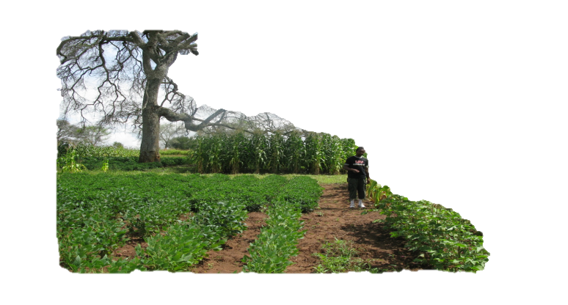

Thank you
Martien van Nieuwkoop, Global Director, Agriculture & Food
MvanNieuwkoop@worldbank.org

Slide 12
Annex: Public Finance: Aligning Incentives for Adoption of Climate Smart Agriculture Options
Public Support to Agriculture by Category (2015-17)
Total: US$ 570 billion per year
Equivalent to 28% of Agriculture Sector Value Added
Two forms of public support have the most distortive potential:
    Coupled subsidies (i.e., tied to inputs or outputs): fertilizer subsidies, in particular, have contributed to the overuse of nitrogen fertilizer globally resulting in high GHG emissions and other environmental problems;
    Price support, which encourages over-production of certain commodities and inefficient use of limited natural resources, and in some notable cases encourage land use conversion
Environmental Purposes
1%

Slide 13
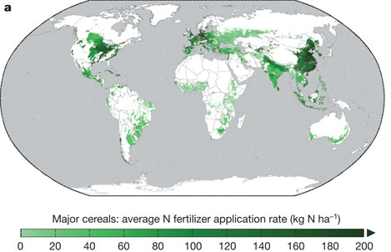
Annex: Better nutrient management for raising yields and decreasing greenhouse gases needed
ND Mueller et al. Nature 000, 1-4 (2012) doi:10.1038/nature11420

Slide 14
What makes the project stand out
What
How
  The focus is agricultural production in a sustainable way. The project emphasizes increasing farmers’ productivity, while lowering emissions and impact on the natural environment.
  With a population of 3.7 million people, Uruguay currently produces food for 28 M people. The vision by 2050 is to produce food for 50 million people.
  Taking a climate-smart agricultural approach, the country has quadrupled its agricultural production within a decade, while increasing the resilience and adaptation of their productive systems to climate change, and significantly reducing GHG emission associated with food production.
  The project has supported the set-up and design of the National Agricultural Information System (SNIA).
  SNIA facilitates the integration of dispersed agriculture, natural resource management and new climate-related information from 32 national agencies in an online state-of-the-art platform tailored to the needs of different users.
  Farmers access to internet allows the application of early-warning system for livestock management, an agrochemical control system, rural risk assessments, soil and land use plans, water studies for irrigation and precise climate forecasts.
  To date it has seen over 70,000 uses and supported 9 important public-sector decisions.
  Driving innovation in climate-smart agricultural agenda

