Slide 1
Improving nutrient use efficiency for sustainable agricultural systems
Dr. Yvonne Harz- Pitre
Director of Communications and Public Affairs

Slide 2
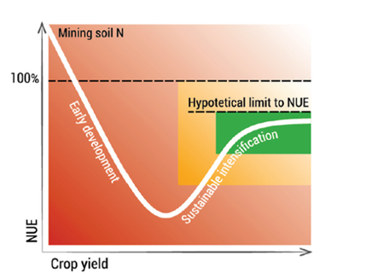
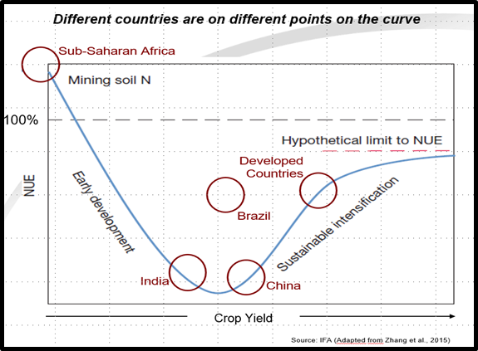
Crucial to improve fertilizer use efficiency (NUE) worldwide
NUE= N input/N output

Slide 3
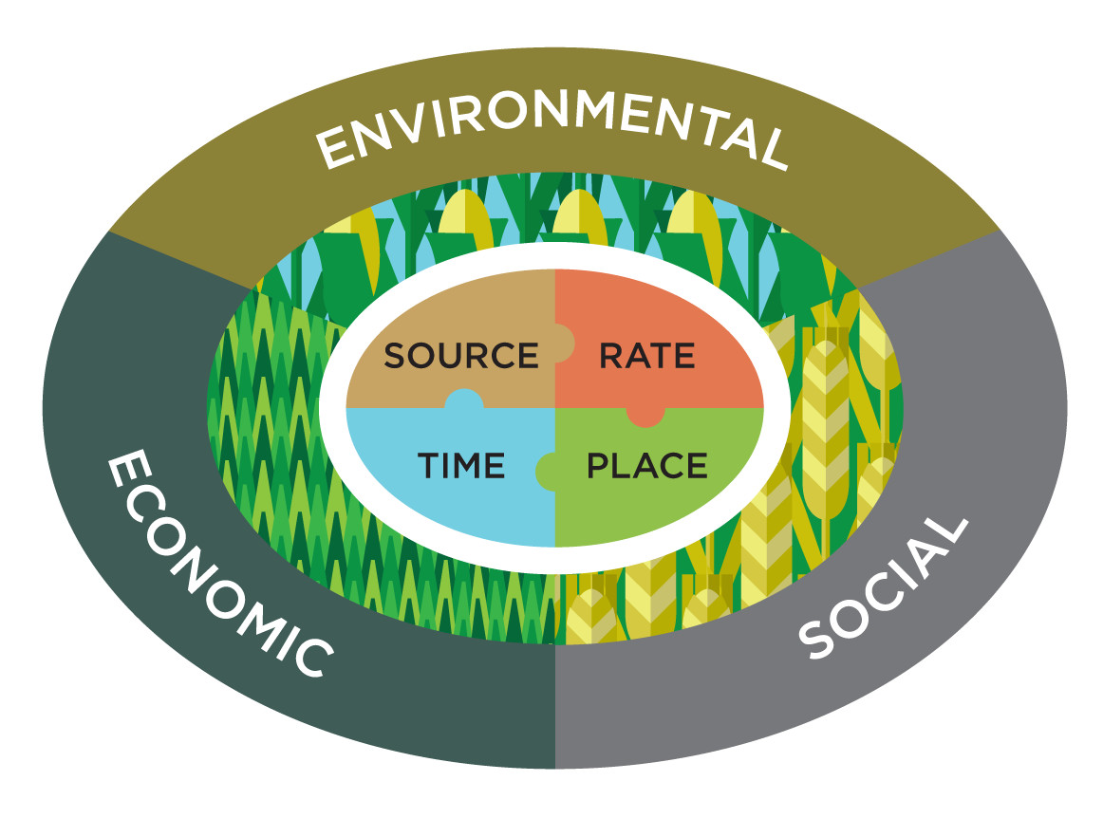
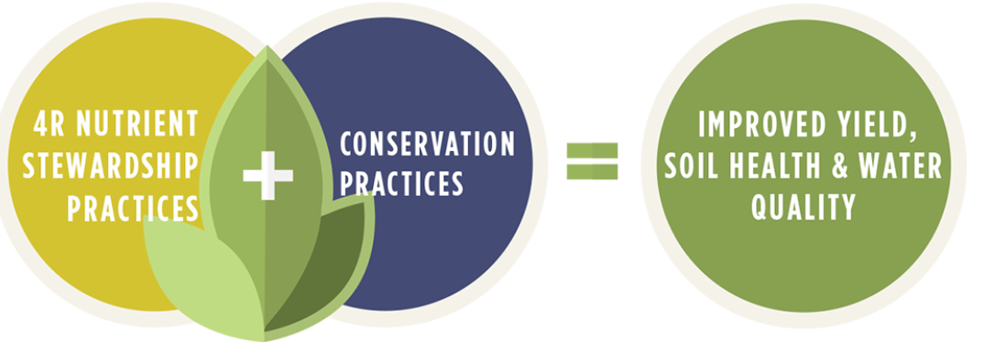
Fertilizer Best Management Practices: 4Rs
Right fertilizer Source, at the Right Rate, at the Right time and in the Right Place
Conservation practices include: Cover crops; No-till; Strip-till; Grass waterways; Drainage water management etc

Slide 4
Fertilizer Best Management Practices
Also part of the 4R toolbox:
Integrated Plant Nutrient Management (IPNM): applying on-farm organic fertilizers and supplementing them with mineral fertilizers
Balanced fertilization, i.e. assuring a proper supply of all macronutrients and micronutrients in a balanced ration;
Site-specific nutrient management (SSNM), i.e. supplying plants with nutrients to optimally match their needs for nutrients;
Fertigation, entails combining fertilizers with irrigation water.

