Slide 1
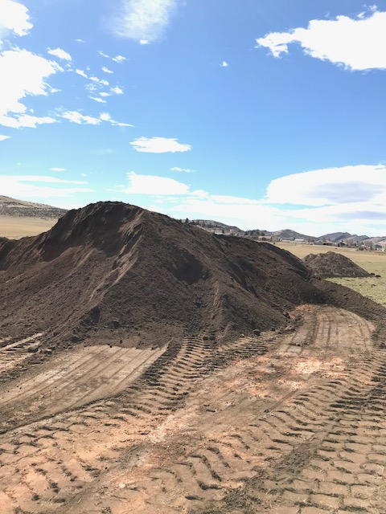
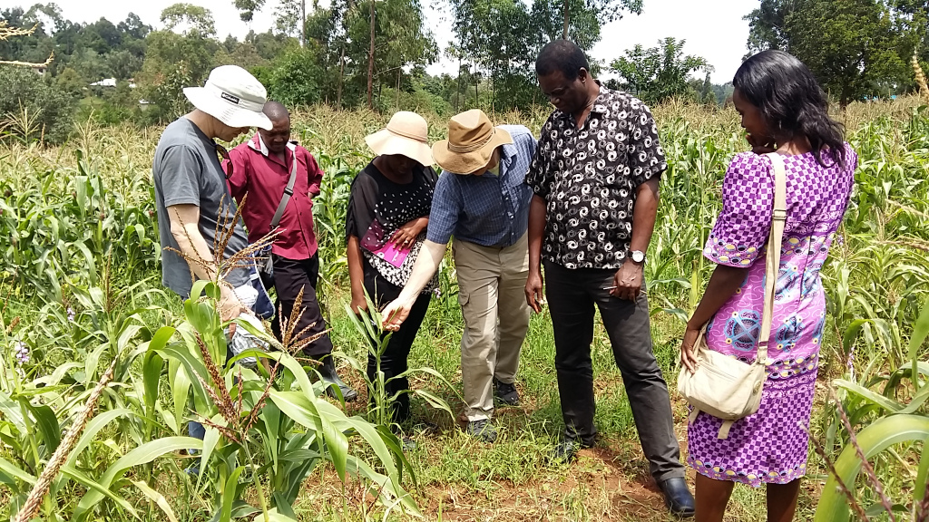
Improved Nutrient Use & Manure Management Towards Sustainable & Resilient Agricultural Systems
Photo: Shelby McClelland
Colorado State University
Shelby McClelland
Ph.D. Candidate
December 03-04, 2019
Koronivia Joint Work on Agriculture Civil Society Panel
Photo: Blessing Magonziwa

Slide 2
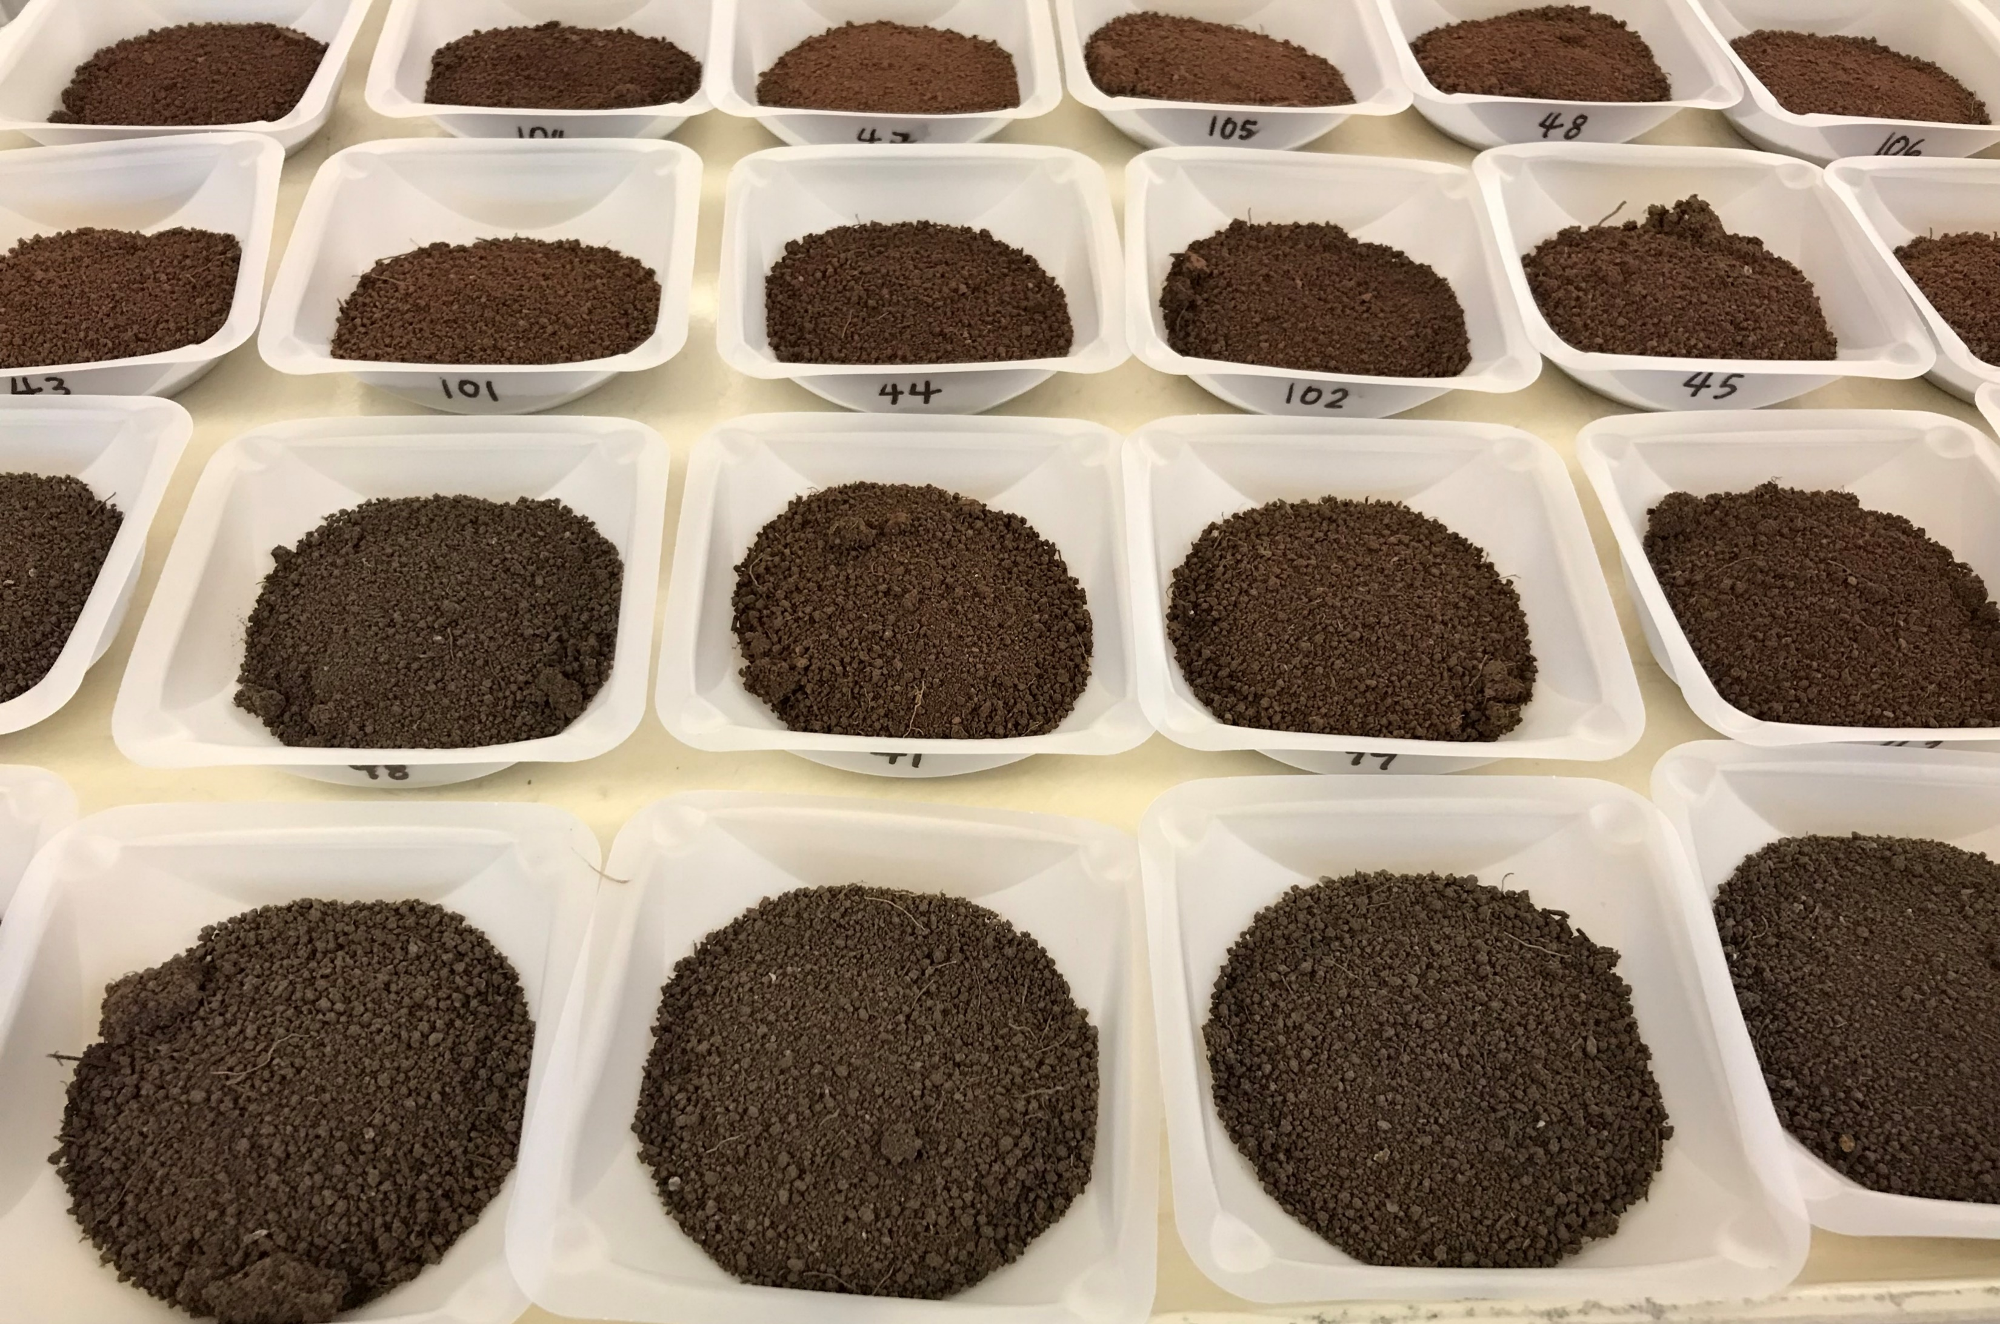
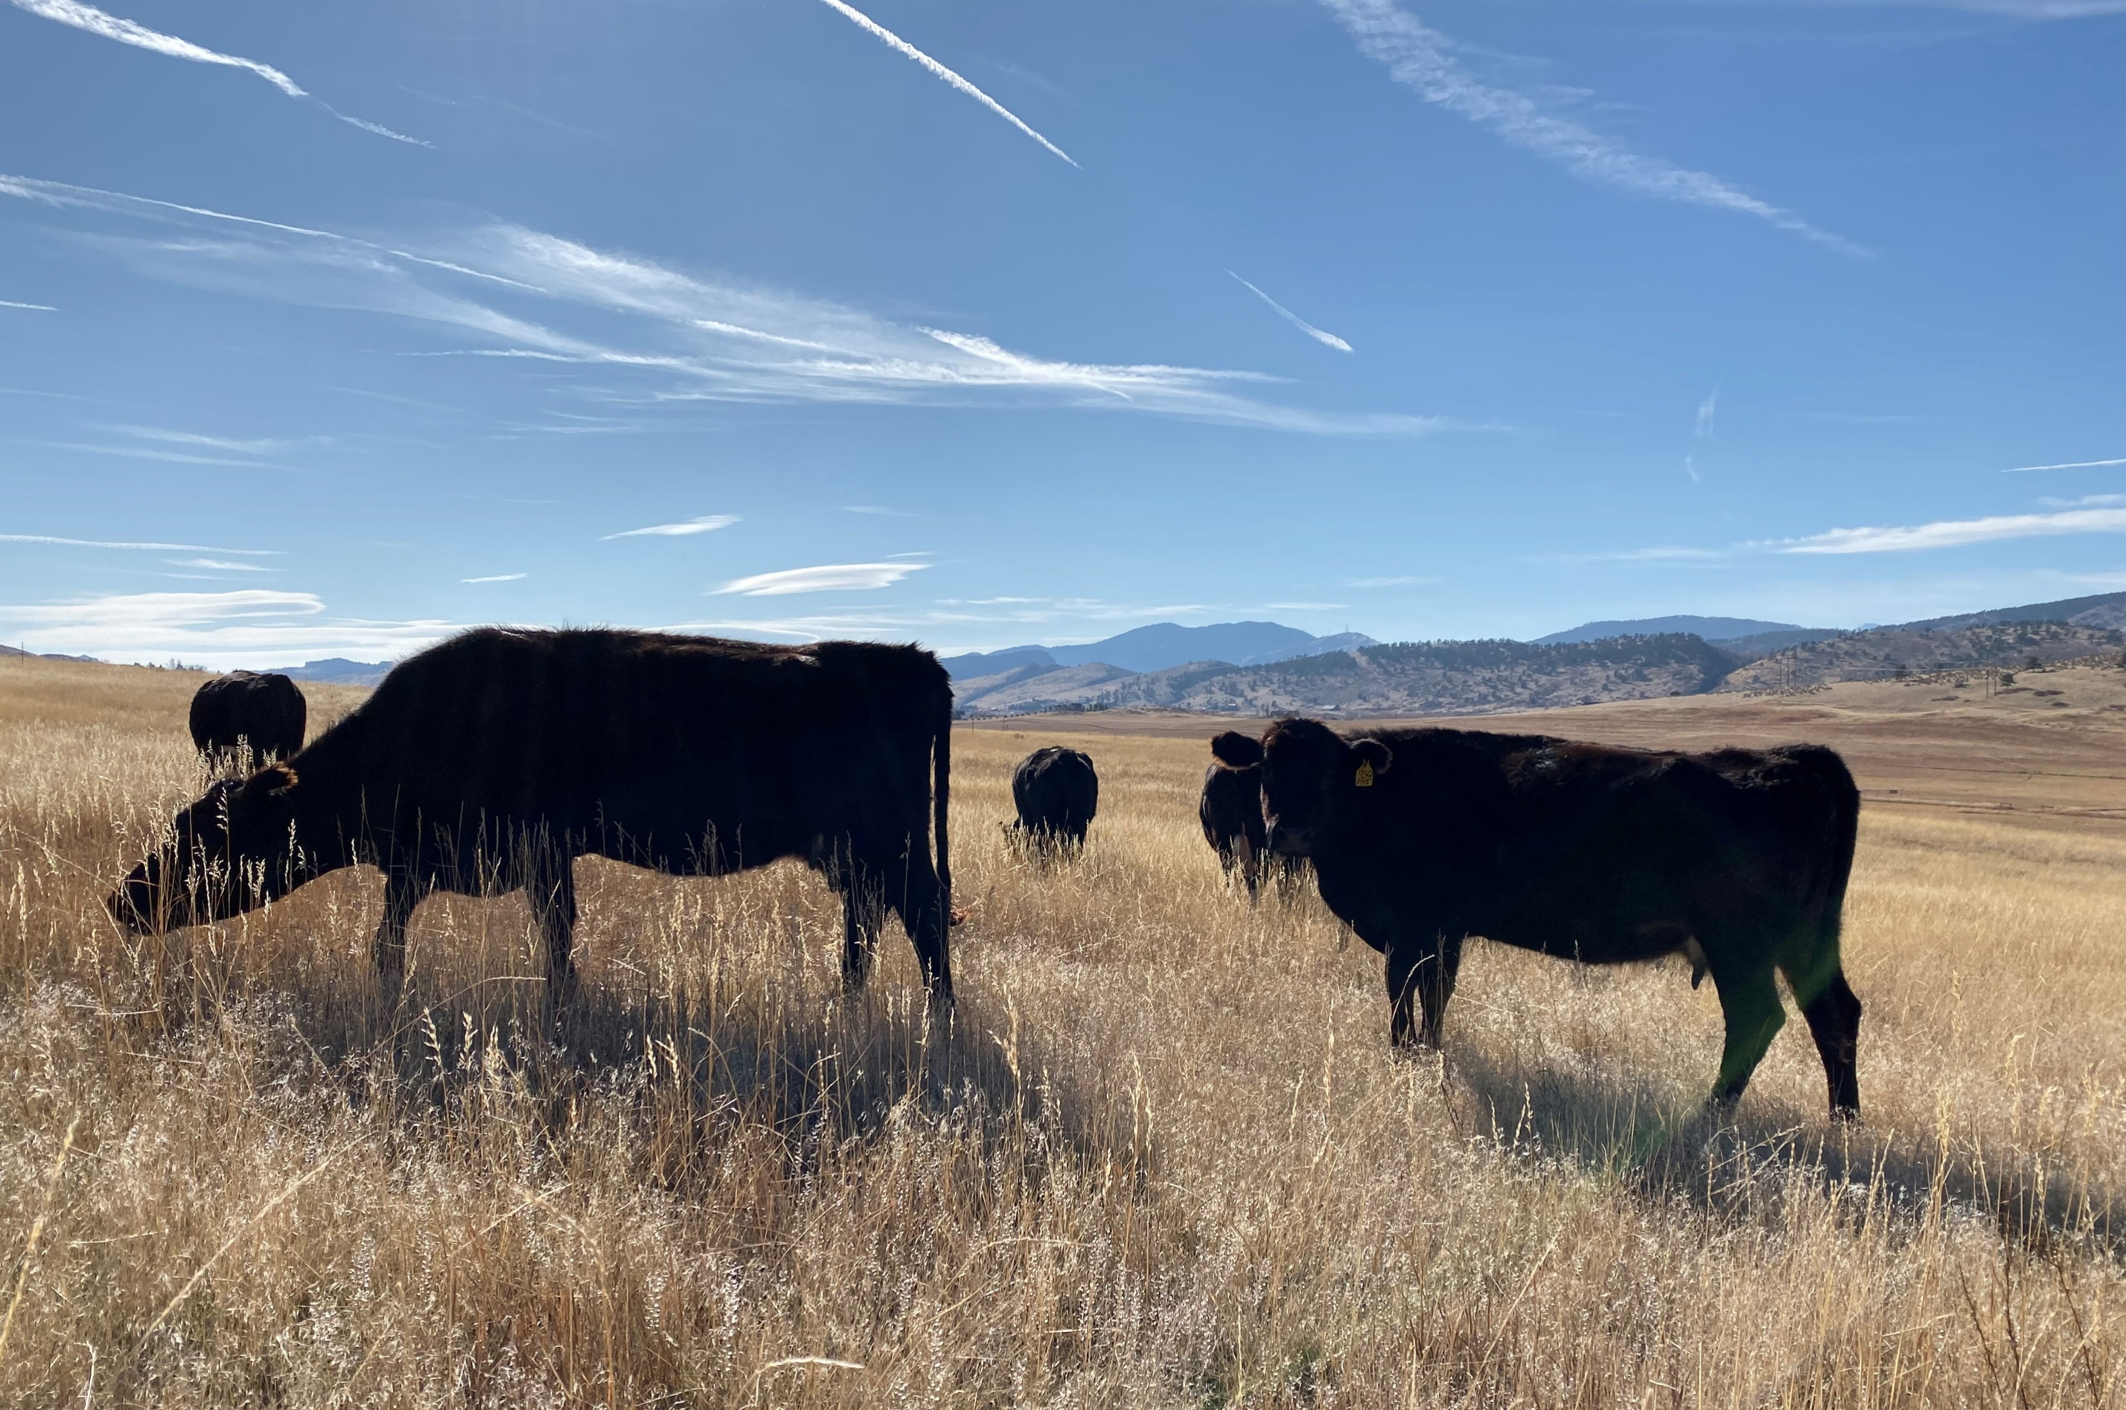
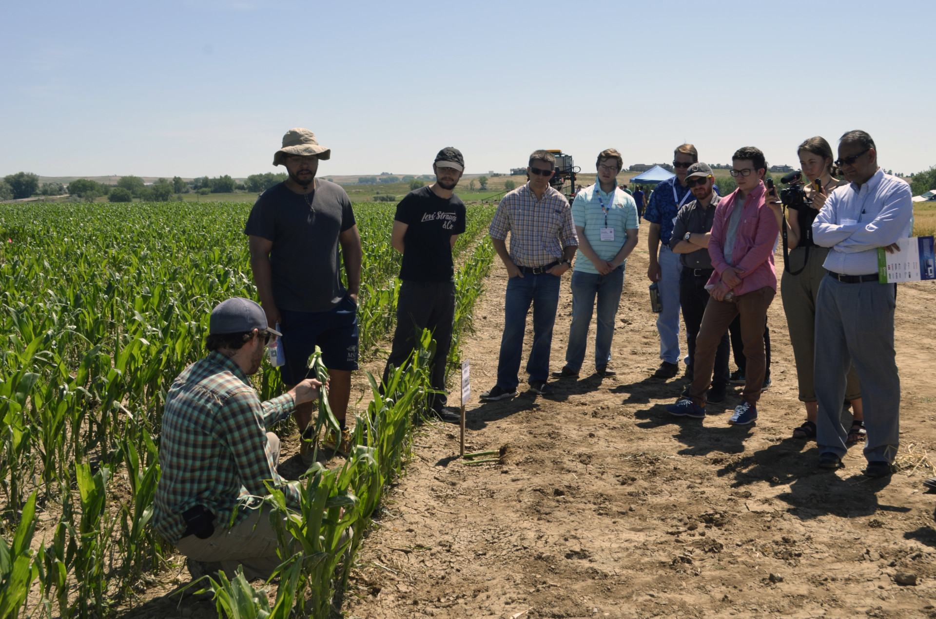
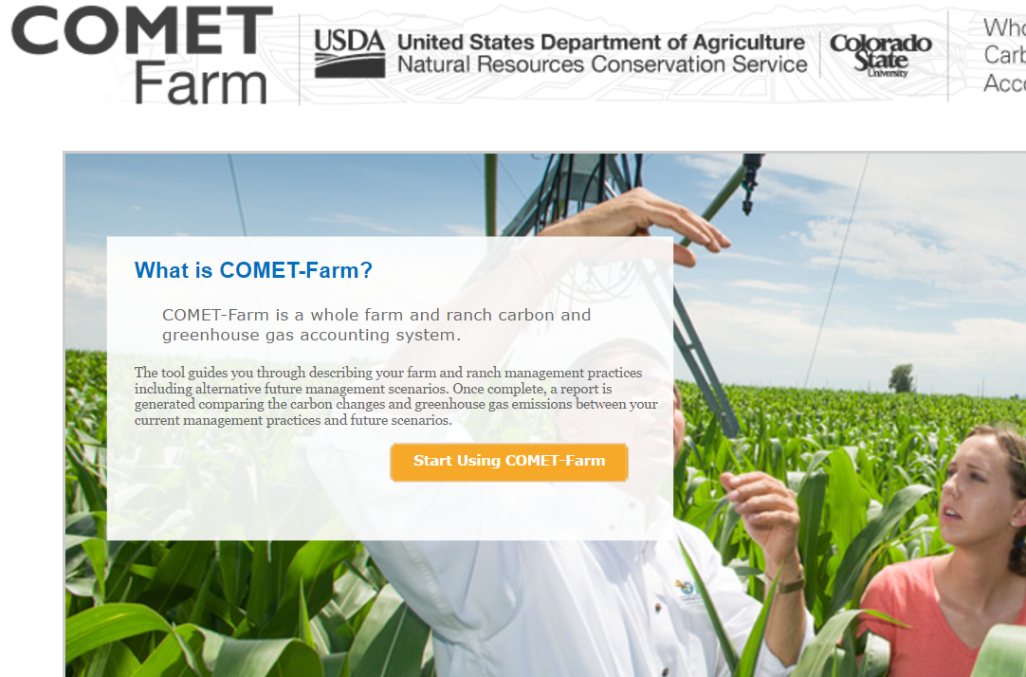
Challenges and barriers
Soil organic N as a primary N resource in agroecosystems
Decoupled crop-livestock systems
Link between soil nutrients & crop quality
Robust & relevant decision-support tools
1
2
3
4
02
Koronivia Joint Work on Agriculture Civil Society Panel

Slide 3
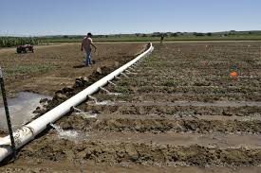
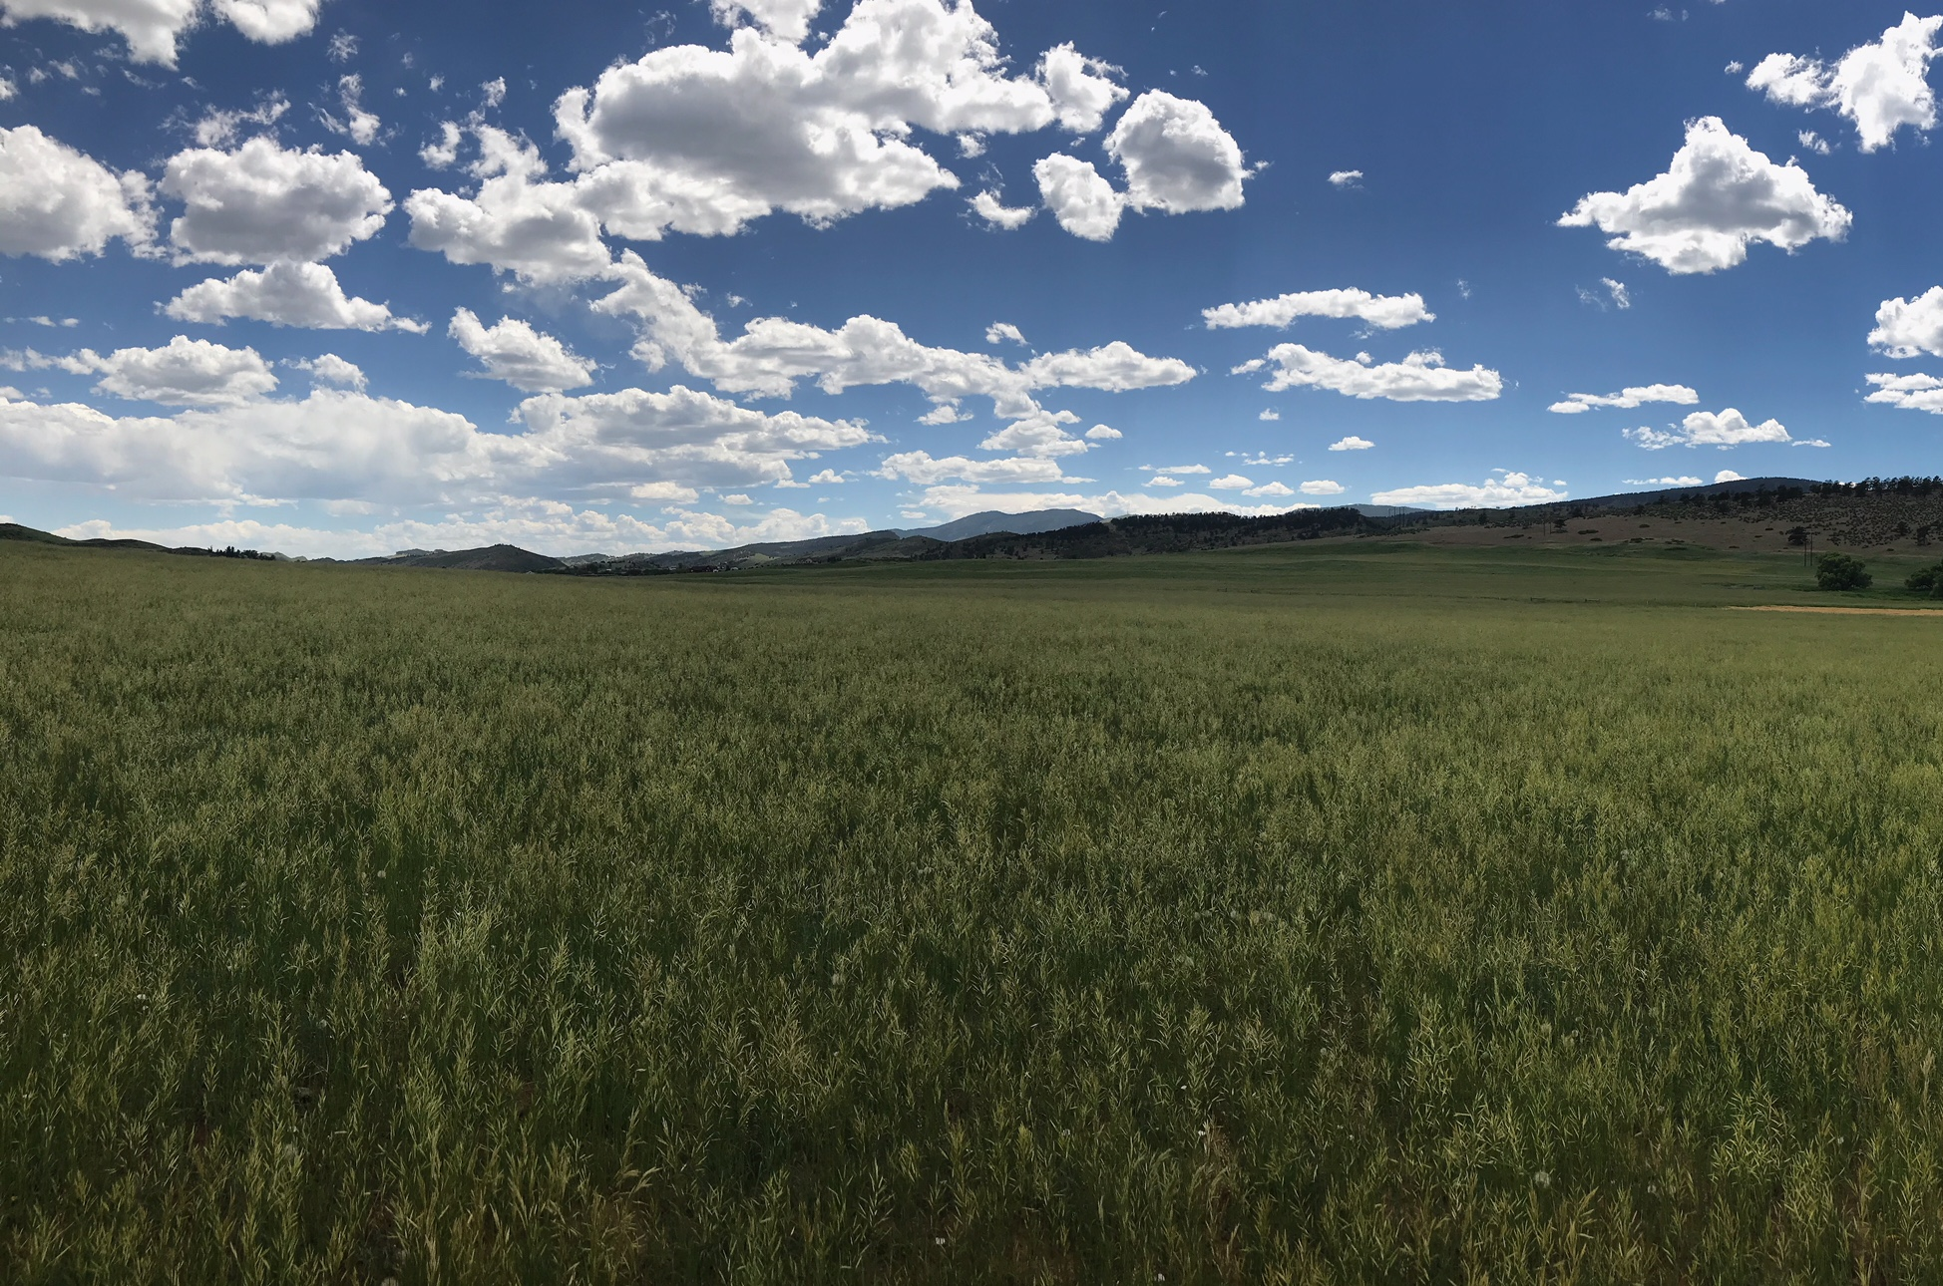
How can the KJWA and the UNFCCC address these challenges?
Source: Colorado State University
Expand nitrogen nutrient management frameworks
Koronivia Joint Work on Agriculture Civil Society Panel
Soil organic nitrogen is a key crop nitrogen source.
Incentivize coupled crop-livestock systems
Photo: Blessing Magonziwa
Remove structural & financial barriers.
Invest in robust decision-support tools
03
Allow for management flexibility to meet targets.
Photo: Roman Borys

Slide 4
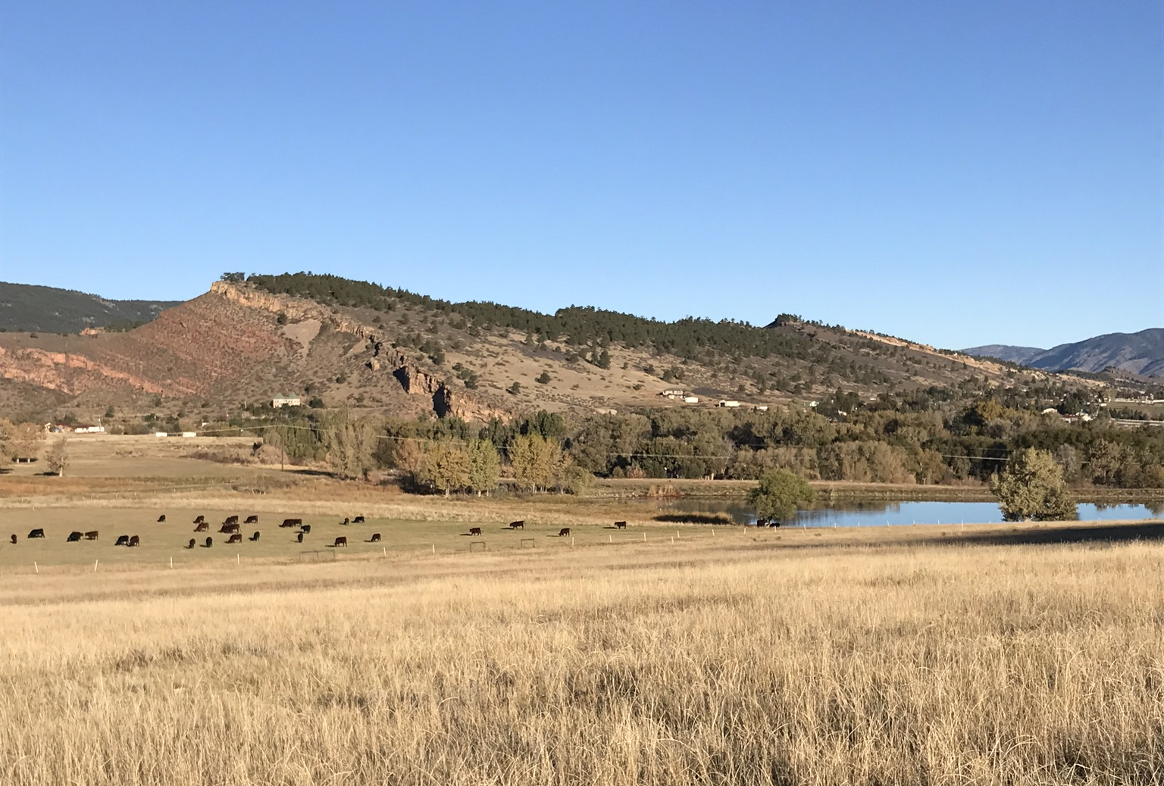
Thank You
Manure Fertilization & Crop Quality
ars.usda.gov | grace.miner@colostate.edu
Research Team
Grace Miner
Jim Ippolito
Jorge Delgado
Composting, Grazing, and Soil Health
sylvandale.com
Research Team
Shelby C. McClelland
Meagan E. Schipanski
David Jessup (Producer)
Koronivia Joint Work on Agriculture Civil Society Panel
Smallholder Soil Health Assessment smallholder-sha.org | blessing.magonziwa@colostate.edu
Research Team
Blessing Magonziwa
Steven Vanek
Steven Fonte
COMET-Farm
cometfarm.nrel.colostate.edu
Research Team
Keith Paustian
Mark Easter
04
@shelbycarol27
shelby.mcclelland@colostate.edu

